Slide 1



STRUCTURED COURSE
An Introduction to Deneb
Declarative Visualization in Power BI
with Greg Philps
Notes:
*** SETUP ***
Set desktop background to black
(don’t worry about taskbar clock & weather widget – will blur during video editing)
Turn off Skype notifications
Turn on PowerToys \ Awake
Open PowerPoint
< VIDEO NOTES >
Hi everyone, Greg Philps here. I’ve been impressed so much recently by the new custom visual, DENEB, that Daniel Marsh-Patrick has made available for Power BI. This custom visual allows the use of the VEGA-LITE JSON-based language to describe a visual in full code. VEGA-LITE is a DECLARATIVE language, not an IMPERATIVE one, in that it describes what a visual should do rather that how it should do it.
VEGA-LITE has been around for a while and is a well-established grammar for interactive graphics.
The DENEB custom visual allows visuals to be coded in VEGA-LITE to use data from within Power BI files. DENEB further is fully-integrated with Power BI in that it responds to the selections made in other Power BI visuals (for example, slicers) and adjusts the data displayed accordingly.
In this course, we’ll explore 3 main areas of DENEB:
General DESCRIPTIONS of some of the features of the DENEB visual and the VEGA-LITE language,
Specific characteristics of some common VISUAL TYPES in VEGA-LITE, and
A few illustrative EXAMPLES of start-to-finish Deneb visuals
So, we’ll start with an overview of
What is Deneb?
What is Vega-Lite?
How to get and install Deneb
The Deneb interface
The structure of Deneb and Vega-Lite code blocks
Vega-Lite options for creating composite visuals
Deneb options for integrating with the theme colours of a Power BI file
Next, we’ll move onto descriptions of
Bar and Column Charts
Line and Area Charts
Heat Maps
Circular Charts
Linked Charts
Composite Charts
Then we’ll explore a few examples of start-to-finish Deneb development for:
A BAR chart with Internal Labels and Values
A GANTT chart
2 LINKED charts – a Scatter Chart and a Bar Chart
Finally, we’ll do a quick review of how to generate and use templates within Deneb, and how the use of Visual Studio Code can aid your development.
So let’s move on to Deneb itself.
< DONE >

Slide 2

What is Deneb?
A custom visual for Power BI
Astronomy: Deneb is the brightest star in the constellation of Cygnus, and along with Vega and Altair, makes up the astronomical star grouping called the Summer Triangle
Power BI: Deneb exposes the Vega and Vega-Lite languages in Power BI
History
Available as a certified custom visual from AppSource as version 1.0 in December 2021
Upgraded to version 1.1 in late February 2022
Version 1.2 is rolling-out as of late April 2022
A full-code experience using JSON syntax as prescribed by the Vega-Lite grammar for interactive visuals
Vega-Lite has been extended by the Deneb custom visual with additional JSON properties to enhance its capabilities within Power BI
See https://deneb-viz.github.io/ for full details
EMPOWERING POWER BI USERS
TO CHANGE THEIR WORLD
Notes:
*** SETUP ***
Set desktop background to black
(don’t worry about taskbar clock & weather widget – will blur during video editing)
Turn off Skype notifications
Open PowerPoint
Open Chrome to the DENEB website
< VIDEO NOTES >
Hi everyone, Greg Philps here. So what is Deneb? Well, DENEB is a custom visual for Power BI that exposes the well-established VEGA and VEGA-LITE grammars for interactive visuals to Power BI. DENEB has been certified by Microsoft, which should give many organizations a level of comfort in its use. (It is not unusual for organizations to permit only certified custom visuals to be used in their Power BI environment, so certification is important.) DENEB was certified in version 1.0 in December 2021, was upgraded to version 1.1 in February 2022, and is being upgraded to version 1.2 in late-April 2022. (Version 1.1 was the version available during the pre-production for these videos, but 1.2 may be rolled-out and thus used during some of the demonstrations.)
DENEB allows a full-code experience for visual development in Power BI using the high-level JSON syntax of VEGA or VEGA-LITE. (We’ll be using VEGA-LITE from here on in, as it’s a higher-level language and is, I find, easier to read and understand.) In addition, the DENEB custom visual implements some additional JSON properties which extend and enhance the integration of VEGA-LITE into the Power BI environment.
Daniel Marsh-Patrick has done a terrific job describing and documenting the DENEB custom visual fully on the Deneb website, and I encourage everyone to spend some time here to familiarize yourself with all of Deneb’s capabilities.
https://deneb-viz.github.io/
Let’s look at a few high points:
(use ZOOMIT CTRL + 2, r, CTRL to draw RED rectangles)
Ensure you have the desired version of Deneb selected in the drop-down list near the right of the toolbar (in this case, 1.1)
Use the GETTING STARTED section to explore how to install DENEB in your Power BI environment
Use the SIMPLE WORKED EXAMPLE section for an introduction on how to use DENEB
Use the VISUAL EDITOR section to familiarize yourself with the DENEB interface
As an aside, for those that wonder where the name DENEB came from, my understanding is that its from ASTRONOMY in general and the constellation of CYGNUS in particular, where Deneb is Cygnus’ brightest star, and along with Vega and Altair, makes up the astronomical star grouping called the Summer Triangle.
With VEGA-LITE and VEGA being well-known languages for interactive graphics, and Altair being the name of a common interface for visualizing data using the VEGA and VEGA-LITE languages, then it seems that the name DENEB fits nicely.
We’ll move on to describing VEGA-LITE in the next module.
< DONE >

Slide 3
What is Vega-Lite? (1/2)
A JSON grammar for describing interactive visuals, and is exposed by many different interfaces, including:
Altair (an API in Python)
Deneb (a custom visual in Power BI) [and the one we’re interested in here]
Receives a dataset from Power BI in the DATA code block
"data": {"name": "dataset"}
A visual can contain many MARKs
MARKs can be arranged in LAYERs or CONCATENATIONs
EMPOWERING POWER BI USERS
TO CHANGE THEIR WORLD
Notes:
*** SETUP ***
Set desktop background to black
(don’t worry about taskbar clock & weather widget – will blur during video editing)
Turn off Skype notifications
Open PowerPoint
Open Chrome to the VEGA-LITE website
< VIDEO NOTES >
Hi everyone, Greg Philps here. So what is Vega-Lite? VEGA-LITE is a “grammar of graphics” that uses a JSON format to describe interactive visuals. (The container, in our case the DENEB custom visual, takes the VEGA-LITE description and renders a visual.) VEGA-LITE is declarative, rather than instructive, in that it describes what the visual does, rather than how it does it. VEGA-LITE was developed by the University of Washington IDL, or Interactive Data Lab, and is used by a large number of different tools to author visualizations. Altair is an API that is frequently used in Python for implementing VEGA-LITE visualizations, while DENEB is the tool that permits the VEGA-LITE language to be used inside of Power BI.
For much more information about the design, structure, and examples of the VEGA-LITE language, one can browse the DOCUMENTATION section of the VEGA-LITE website:
https://vega.github.io/vega-lite/docs/
Let’s just have a look at a few of the high points:
(use ZOOMIT CTRL + 2, b, CTRL to draw BLUE rectangles)
Use the MARK section of the navigation menu to explore the different MARKs available in VEGA-LITE
Use the ENCODING section of the navigation menu section to explore the different encoding PROPERTIES available for different MARKs
Use the VIEW COMPOSITION section of the navigation menu to explore the different types of COMPOSITE visuals that can be created with VEGA-LITE
A simple description is that VEGA-LITE receives a dataset in its DATA block and then uses the specification in its MARK and ENCODING blocks to display and characterize that data. A VEGA-LITE visualization can actually contain many MARKs, and the final visualization can actually be composed of a set of component visuals; these component visuals are described individually but the final visualization is composed of LAYERs or CONCATENATIONs to achieve the desired result.
<<< GO TO NEXT SLIDE >>>

Slide 4
What is Vega-Lite? (2/2)
Data is tied to a MARK
Bar, line, arc, point, text, etc.
A mark has ENCODING which can be used to adjust the display
Text mark encodings include alignment, position, font, size, color
Multiple marks can be combined to create composite visuals
Layer – overlapping
Concatenation – vertically or horizontally, or wrapping
Facet – like small multiples in many existing Power BI visuals, where a series of similar plots are used to display subsets of the same data, facilitating comparison across subsets
Repeat
like “faceting”, but used instead to display the full set of data multiple times
“repeats” a visual specification for each fieldname in an array of fieldnames
EMPOWERING POWER BI USERS
TO CHANGE THEIR WORLD
Notes:
*** SETUP ***
Set desktop background to black
(don’t worry about taskbar clock & weather widget – will blur during video editing)
Turn off Skype notifications
Open PowerPoint
Open Power BI THEORY file
Open Chrome to the Vega-Lite website
< VIDEO NOTES >
<<< CONTINUED FROM LAST SLIDE >>>
While the DATA block in the VEGA-LITE JSON code contains the data that will be used in the visualization, the MARK and ENCODING blocks will be where most of the development work with VEGA-LITE will occur. Let’s just take a quick look at our sample visual.
<<< DEMO >>>
(use ZOOMIT CTRL + 2, r, CTRL to draw RED rectangles)
(use ZOOMIT CTRL + 2, b, CTRL to draw BLUE rectangles)
Open the Power BI Theory PBIX file to the HOME page
Look at the DENEB visual and use ZOOMIT to highlight the MARK and ENCODING blocks
Open Chrome to the VEGA-LITE website
Look at the MARK navigator, then the TEXT mark details
Look at the VIEW COMPOSITION navigator
The data is presented by a MARK code block, and there are many different marks available, including bar, line, arc, circle, point, etc. The viewer is referred to the Vega-Lite documentation on the Vega-Lite website for a complete listing of the available marks.
Each MARK is mapped, or ENCODED, to make the connection between the DATA and the MARK, as well as to describe the display characteristics of the mark (such as position, size, colour, etc.).
For example, for a TEXT mark, one can specify the ALIGNMENT, POSITION, FONT, SIZE, COLOUR, and many other properties to adjust the display.
As mentioned before, multiple MARKs may be combined to compose the desired visual, and the view composition types fall into 4 categories:
LAYERING
Overlapping visuals that use the same set of axes
CONCATENATION
Vertically concatenated visuals, horizontally concatenated visuals, or wrapping visuals
FACETING
A series of similar visuals, each presenting a subset of the data
(Another way of describing facet-ed visuals is that they are similar to the small multiples available for many Power BI visuals.)
REPEATING
Also, a series of similar views, like FACETING above, but this time a full dataset is provided to each view; the only difference between the views is that a view is created for each entry in an array of fields
OK, that’s a very quick summary of a few major parts of VEGA-LITE code. Again, for a more in-depth treatment, the viewer is referred to the VEGA-LITE website.
https://vega.github.io/vega-lite/
We’ll move on to how to get and install DENEB in the next module.
< DONE >

Slide 5
Getting Deneb
AppSource
Download sample PBIX
GitHub (standalone)
EMPOWERING POWER BI USERS
TO CHANGE THEIR WORLD
Notes:
*** SETUP ***
Set desktop background to black
(don’t worry about taskbar clock & weather widget – will blur during video editing)
Turn off Skype notifications
Open PowerPoint
Open Power BI
< VIDEO NOTES >
Hi everyone, Greg Philps here. To continue our review of Deneb in Power BI, one of the items to pursue is how to get the custom visual. Those who have used custom visuals before will be familiar with the process, namely accessing APP SOURCE and downloading it. For those who haven’t, let’s just go through that.
As an aside, Daniel Marsh-Patrick has detailed the full process in the GETTING STARTED section of the Deneb website.
https://deneb-viz.github.io/getting-started
<<< DEMO >>>
Open Power BI create a new, empty PBIX file
From the VISUALIZATIONS pane, click on the ellipsis (3 dots) and click on GET MORE VISUALS
In the AppSource window that appears, enter DENEB in the SEARCH BOX
Click on the single entry returned (DENEB), then in the resulting window, click the ADD button
A dialog box will confirm that the custom visual was successfully installed; click OK
(If you’re using an existing Power BI file that already contains Deneb visuals, you’ll be asked instead if you’d like to update it.)
(In my particular situation, both that I already have the DENEB custom visual installed, and that version 1.2 is being rolled-out during the recording of this module, I get a slightly different message in the dialog box.)
While you’re there, take advantage of the sample PBIX that Daniel Marsh-Patrick has made available by clicking on the DOWNLOAD SAMPLE button and taking a copy of the sample; review the sample to see some amazing examples of Deneb in action.
A few notes:
Deneb is a certified custom visual, so it is an option for organizations that only permit certified custom visuals in their Power BI environment
For those organizations that don’t permit any custom visuals, an option might be to install the STANDALONE VERSION of the Deneb custom visual, and Daniel Marsh-Patrick has once again provided full details in the GETTING STARTED section of the Deneb website.
So that’s it. We’ll move on to a quick review of the Deneb interface in the next module.
< DONE >

Slide 6
The Deneb Interface (1/6)
The Deneb Interface
Visual Editor pane
Preview area
Properties pane
The Visual Editor pane
Specification Editor Tab
Config Editor Tab
Settings Tab
Command Bar
Apply, auto apply, format
Field mapping
New, generate JSON template, help
The Preview area
Set ZOOM level
Set ZOOM level to 100%
Set ZOOM level to fit available space
The Properties pane
Set JSON Editor font size
Set number of Power BI theme colours to use
EMPOWERING POWER BI USERS
TO CHANGE THEIR WORLD
Notes:
*** SETUP ***
Set desktop background to black
(don’t worry about taskbar clock & weather widget – will blur during video editing)
Turn off Skype notifications
Open PowerPoint
Open Power BI to THEORY pbix
< VIDEO NOTES >
Hi everyone, Greg Philps here. The Deneb interface consists of 3 sections:
The VISUAL EDITOR pane, where you create and edit your VEGA-LITE JSON code
The PREVIEW area, where you see a live PREVIEW of how your code works; and,
The PROPERTIES pane, which is probably the least used, but where you can set the VISUAL EDITOR font size for a visual, which is often used
Let’s take a look. In order to view the Deneb interface, we need to have a Deneb visual to work with, so let’s edit one.
<<< DEMO >>>
Open Power BI to the THEORY pbix file and the HOME page; select the COUNTRY/TOTAL SALES bar chart Deneb visual
Choose EDIT from the ELLIPSIS menu in the top-right corner of the Deneb visual
Select the FORMAT icon in the VISUALIZATIONS pane
Select VISUAL, then right-click EDITOR and click EXPAND ALL CATEGORIES
< GO TO THE NEXT SLIDE (2/6) >

Slide 7
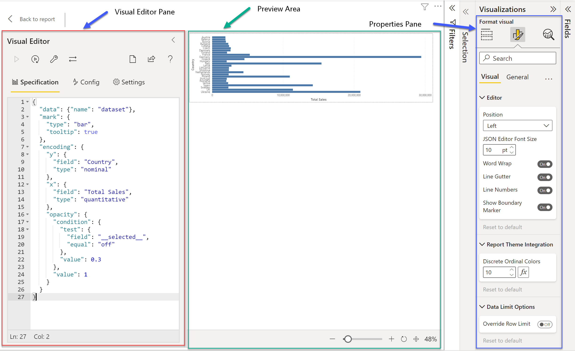
The Deneb Interface (2/6)
Layout
EMPOWERING POWER BI USERS
TO CHANGE THEIR WORLD
Notes:
*** SETUP ***
Set desktop background to black
(don’t worry about taskbar clock & weather widget – will blur during video editing)
Turn off Skype notifications
Open PowerPoint
Open Power BI to THEORY pbix
< VIDEO NOTES >
< CONTINUED FROM LAST SLIDE … >
<<< DEMO >>>
We now see the Deneb interface, and we see there are 3 areas:
The VISUAL EDITOR pane is on the left
The PREVIEW AREA is in the middle
The PROPERTIES PANE is on the right
Let’s look at each of these 3 areas in turn
< GO TO THE NEXT SLIDE (3/6) >

Slide 8
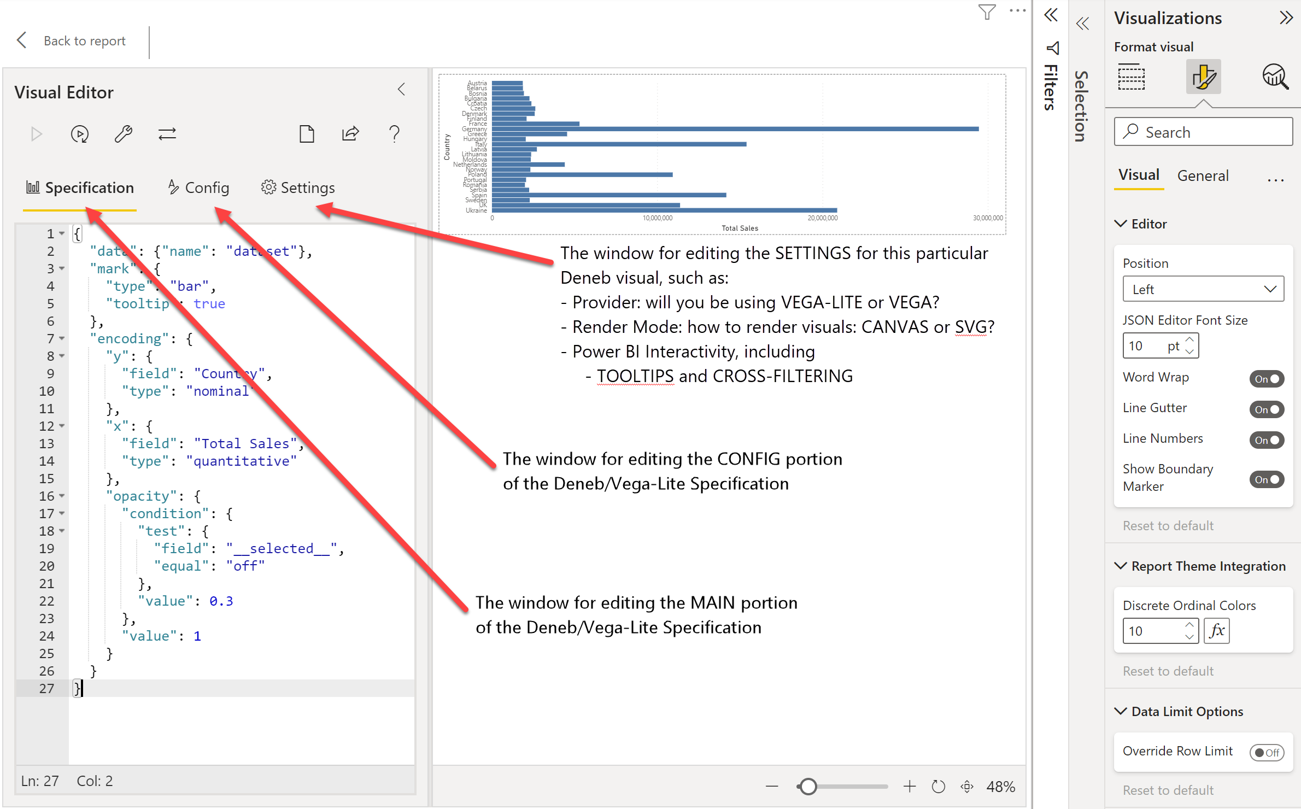
The Deneb Interface (3/6)
Visual Editor (2)
EMPOWERING POWER BI USERS
TO CHANGE THEIR WORLD
Notes:
*** SETUP ***
Set desktop background to black
(don’t worry about taskbar clock & weather widget – will blur during video editing)
Turn off Skype notifications
Open PowerPoint
Open Power BI to THEORY pbix
< VIDEO NOTES >
< CONTINUED FROM LAST SLIDE … >
<<< DEMO >>>
The VISUAL EDITOR pane
There are 2 rows of interest, and we’ll start with the second row first
In the 2nd row, there are 3 choices for SPECIFICATION, CONFIG, and SETTINGS
<<< OPEN PBIX >>>
The 1ST category is for the SPECIFICATION editor; this is where you’ll be doing the vast majority of your D/VL development
The 2nd category is for the CONFIG editor, where you can enter general styling JSON code; another way to think of what goes in here is that its somewhat akin to the cascading style sheets (CSS) that go along with HTML code
The 3rd category is for the SETTINGS, and is where you can specify
What language do you want to use: VEGA-LITE or VEGA?
What rendering mode for your graphics do you want to use: CANVAS or SVG? (I’ve always just left this as is with the default of SVG and have not explored CANVAS graphics, but you can checkout the Deneb website for more details)
What interactivity features do you want to use ?
TOOLTIP HANDLER: on (checked) by default
RESOLVE DATA POINTS IN CONTEXT MENU: on (checked) by default
If ON and, for example, a bar in a bar chart is right-clicked, Deneb will try to provide the same options as a standard Power BI visual (i.e., drill-through, if its applicable)
CROSS-FILTERING: this is off by default, but I most often turn it on to align with the other Power BI visuals in my report
< GO TO THE NEXT SLIDE (4/6) >

Slide 9
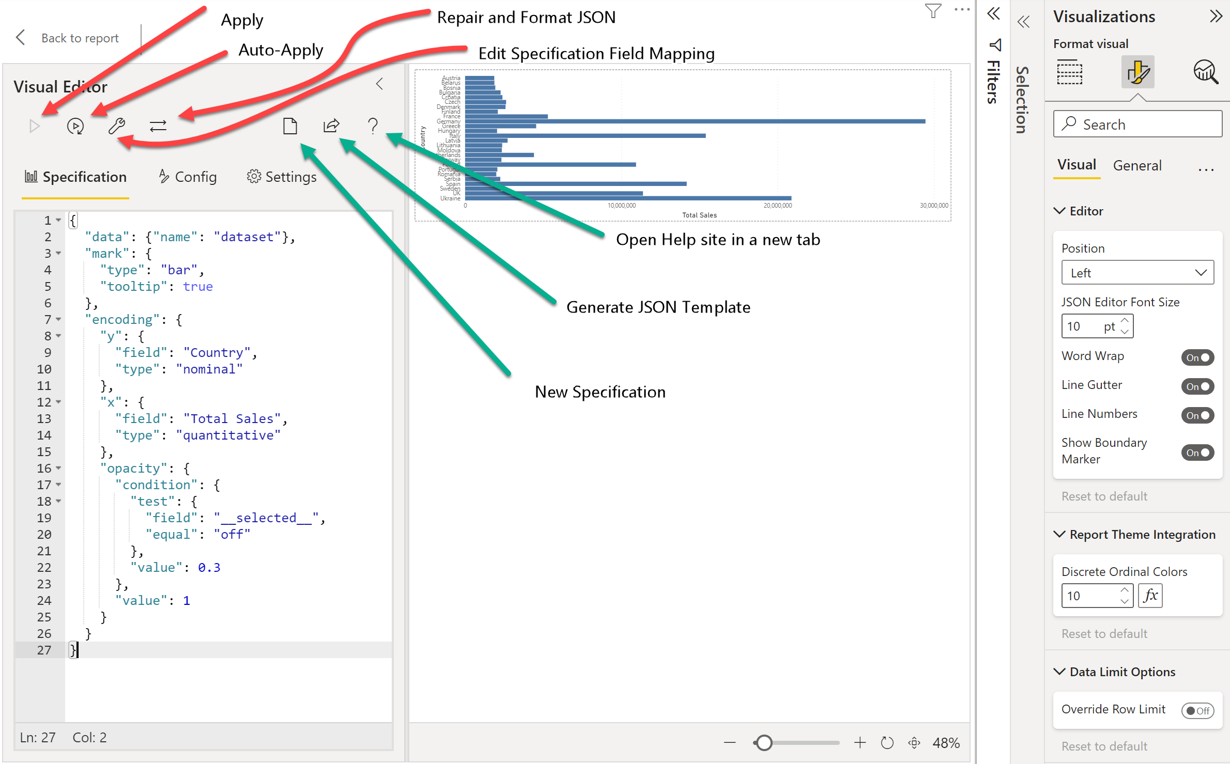
The Deneb Interface (4/6)
Visual Editor (1)
EMPOWERING POWER BI USERS
TO CHANGE THEIR WORLD
Notes:
*** SETUP ***
Set desktop background to black
(don’t worry about taskbar clock & weather widget – will blur during video editing)
Turn off Skype notifications
Open PowerPoint
Open Power BI to THEORY pbix
< VIDEO NOTES >
< CONTINUED FROM LAST SLIDE … >
<<< DEMO >>>
The VISUAL EDITOR pane
In the first row, there are 7 icons for APPLY, AUTO-APPLY, FORMAT, MAPPING, NEW, TEMPLATE, and HELP:
<<< OPEN PBIX >>>
The 1st icon is APPLY; click this to apply your changes to the JSON code
(NOTE that this is greyed-out until Deneb detects that there have been changes to the JSON code)
The 2nd icon is AUTO-APPLY; click this to toggle on/off as to whether to automatically apply your changes to the JSON code as you type
The 3rd icon is REPAIR & FORMAT JSON (the “wrench” icon); this is the one I use the most … I think of it as REPAIR, FORMAT, and APPLY (if my JSON formats correctly, then I’m confident I haven’t added too many or too few commas, braces [curly brackets], or square brackets)
Click the 4th icon to edit the MAPPING of Power BI FIELDS to the D/V-L code; more on this a little later
Click the 5th icon to start a NEW SPECIFICATION; (I’ve very rarely used this)
Click the 6th icon to GENERATE a JSON TEMPLATE; I frequently use this to save the work I’ve done or to create a template for re-use, but I’ll go into this in detail in a separate module, so I won’t pursue it further here
Click the 7th icon to open the HELP site in a new browser tab
Let’s just take a quick look at the setting for field mapping.
<<< DEMO >>>
Open Power BI to the HOME page and duplicate it
Remove the REGIONS[COUNTRY] column from the VALUES field well
Add the CHANNELS[CHANNEL] column to the VALUES field well
Deneb detects that there has been field changes to the visual and presents the EDIT SPECIFICATION FIELD MAPPING screen where you can re-map your fields; select the CHANNEL field from the drop-down to re-map what was previously the COUNTRY field
Now you can see a revised visual with a different Y-axis
In this simple case no additional changes were required, but in some cases there may be minor changes needed for the JSON code to display all correctly after the change; this is part of the BESPOKE nature of the FULL CODE interface for the visual as provided by D/V-L
< GO TO THE NEXT SLIDE (5/6) >

Slide 10
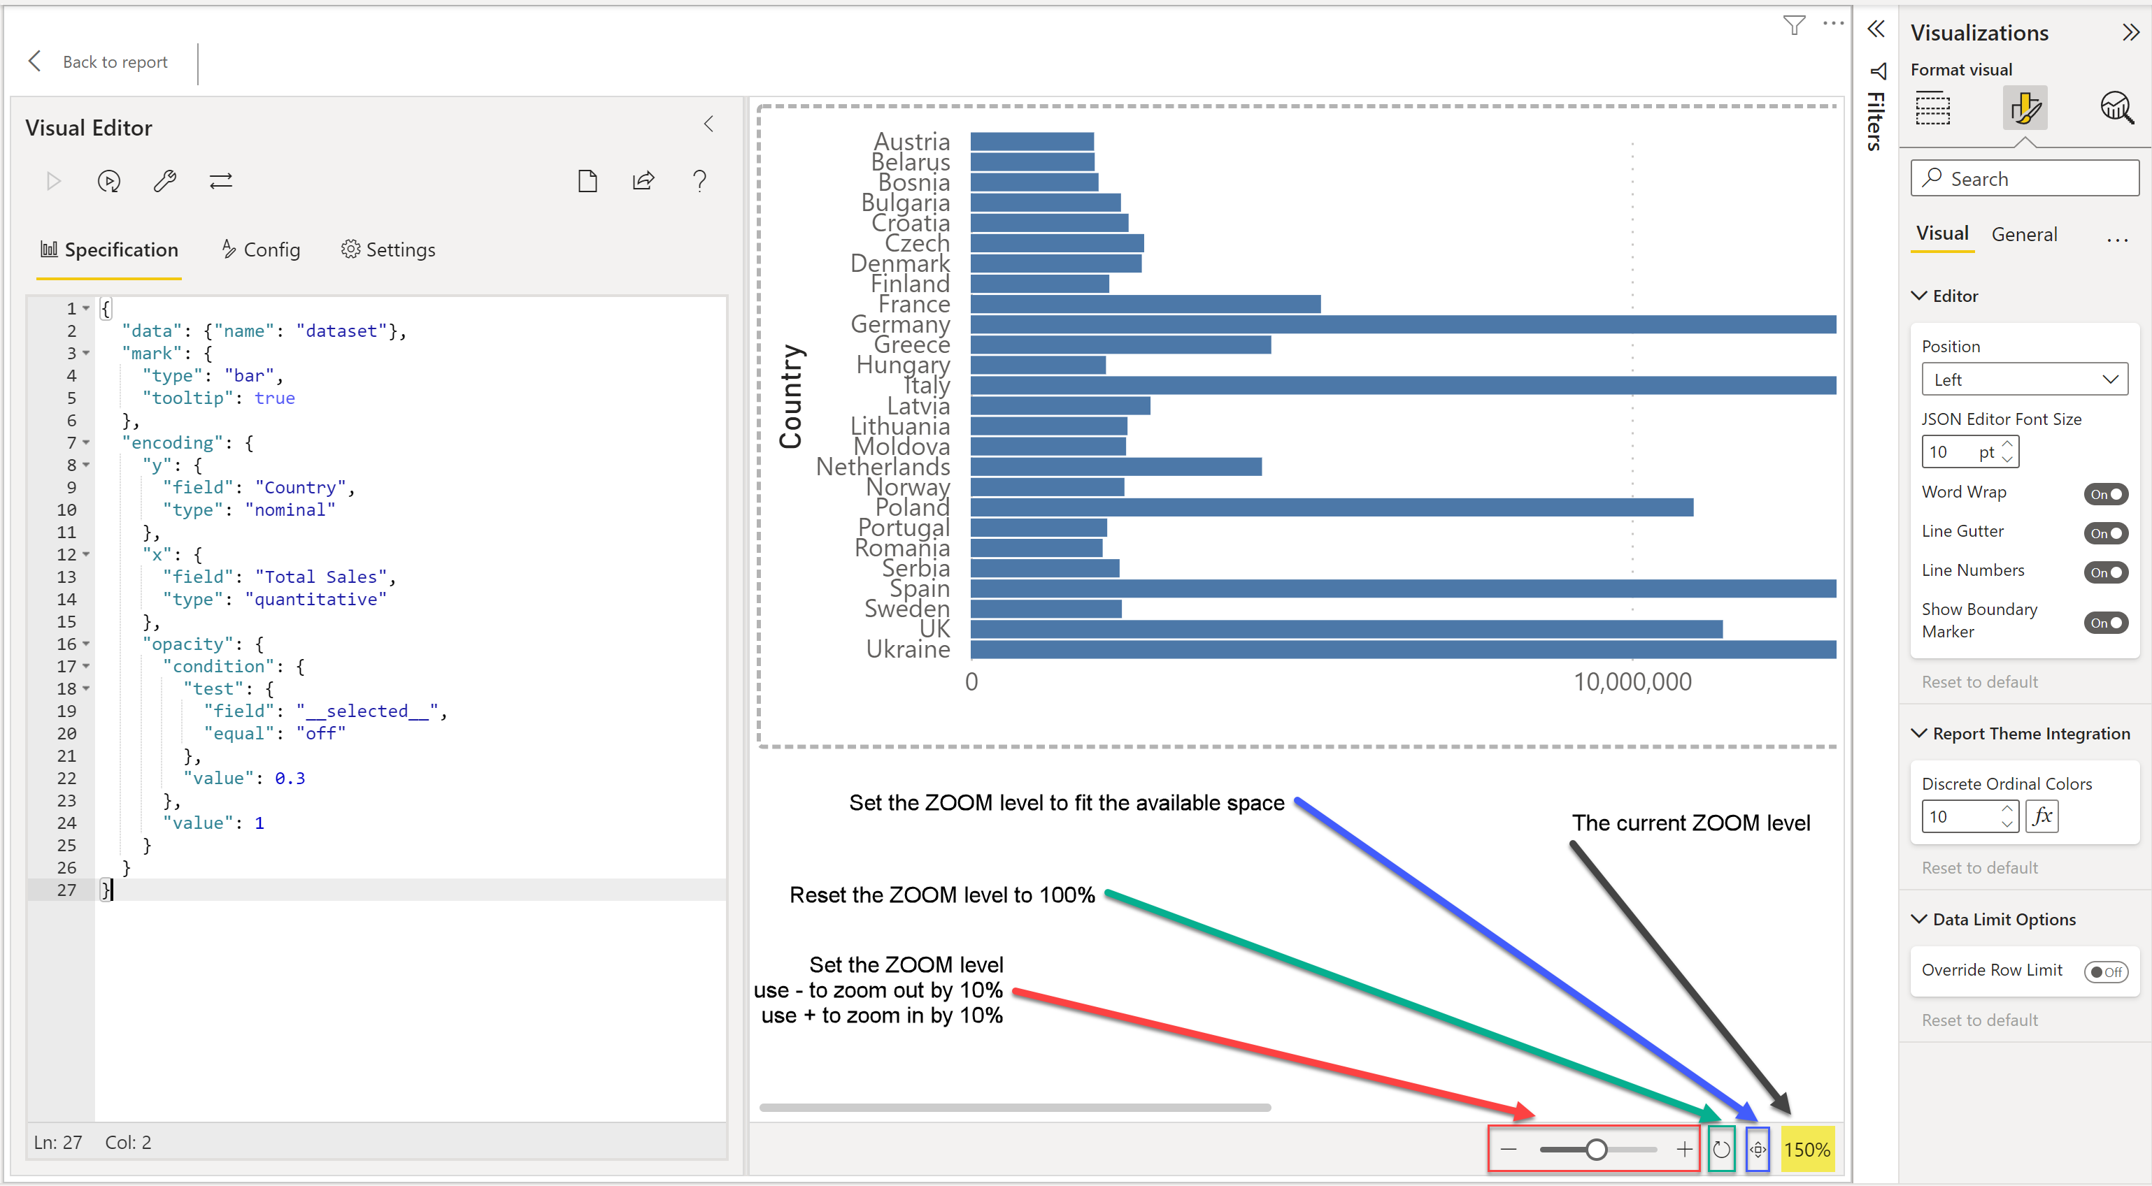
The Deneb Interface (5/6)
Preview Area
EMPOWERING POWER BI USERS
TO CHANGE THEIR WORLD
Notes:
*** SETUP ***
Set desktop background to black
(don’t worry about taskbar clock & weather widget – will blur during video editing)
Turn off Skype notifications
Open PowerPoint
Open Power BI to THEORY pbix
< VIDEO NOTES >
< CONTINUED FROM LAST SLIDE … >
The PREVIEW AREA pane
The preview area is where you can see your visual as you adjust the JSON code. To make it easier to display what you want in the preview area, there are 4 icons at the bottom-right of the preview area for the zoom level
A SLIDER BAR with MINUS and PLUS buttons; use the slider adjust the zoom as desired, or use the “-” button to zoom out by 10% or the “+” button to zoom in by 10%
A RESET icon to reset the zoom to 100%
A FIT icon to set the zoom level to fit the available space, and
A numerical zoom level indicator for your reference
< GO TO THE NEXT SLIDE (6/6) >

Slide 11
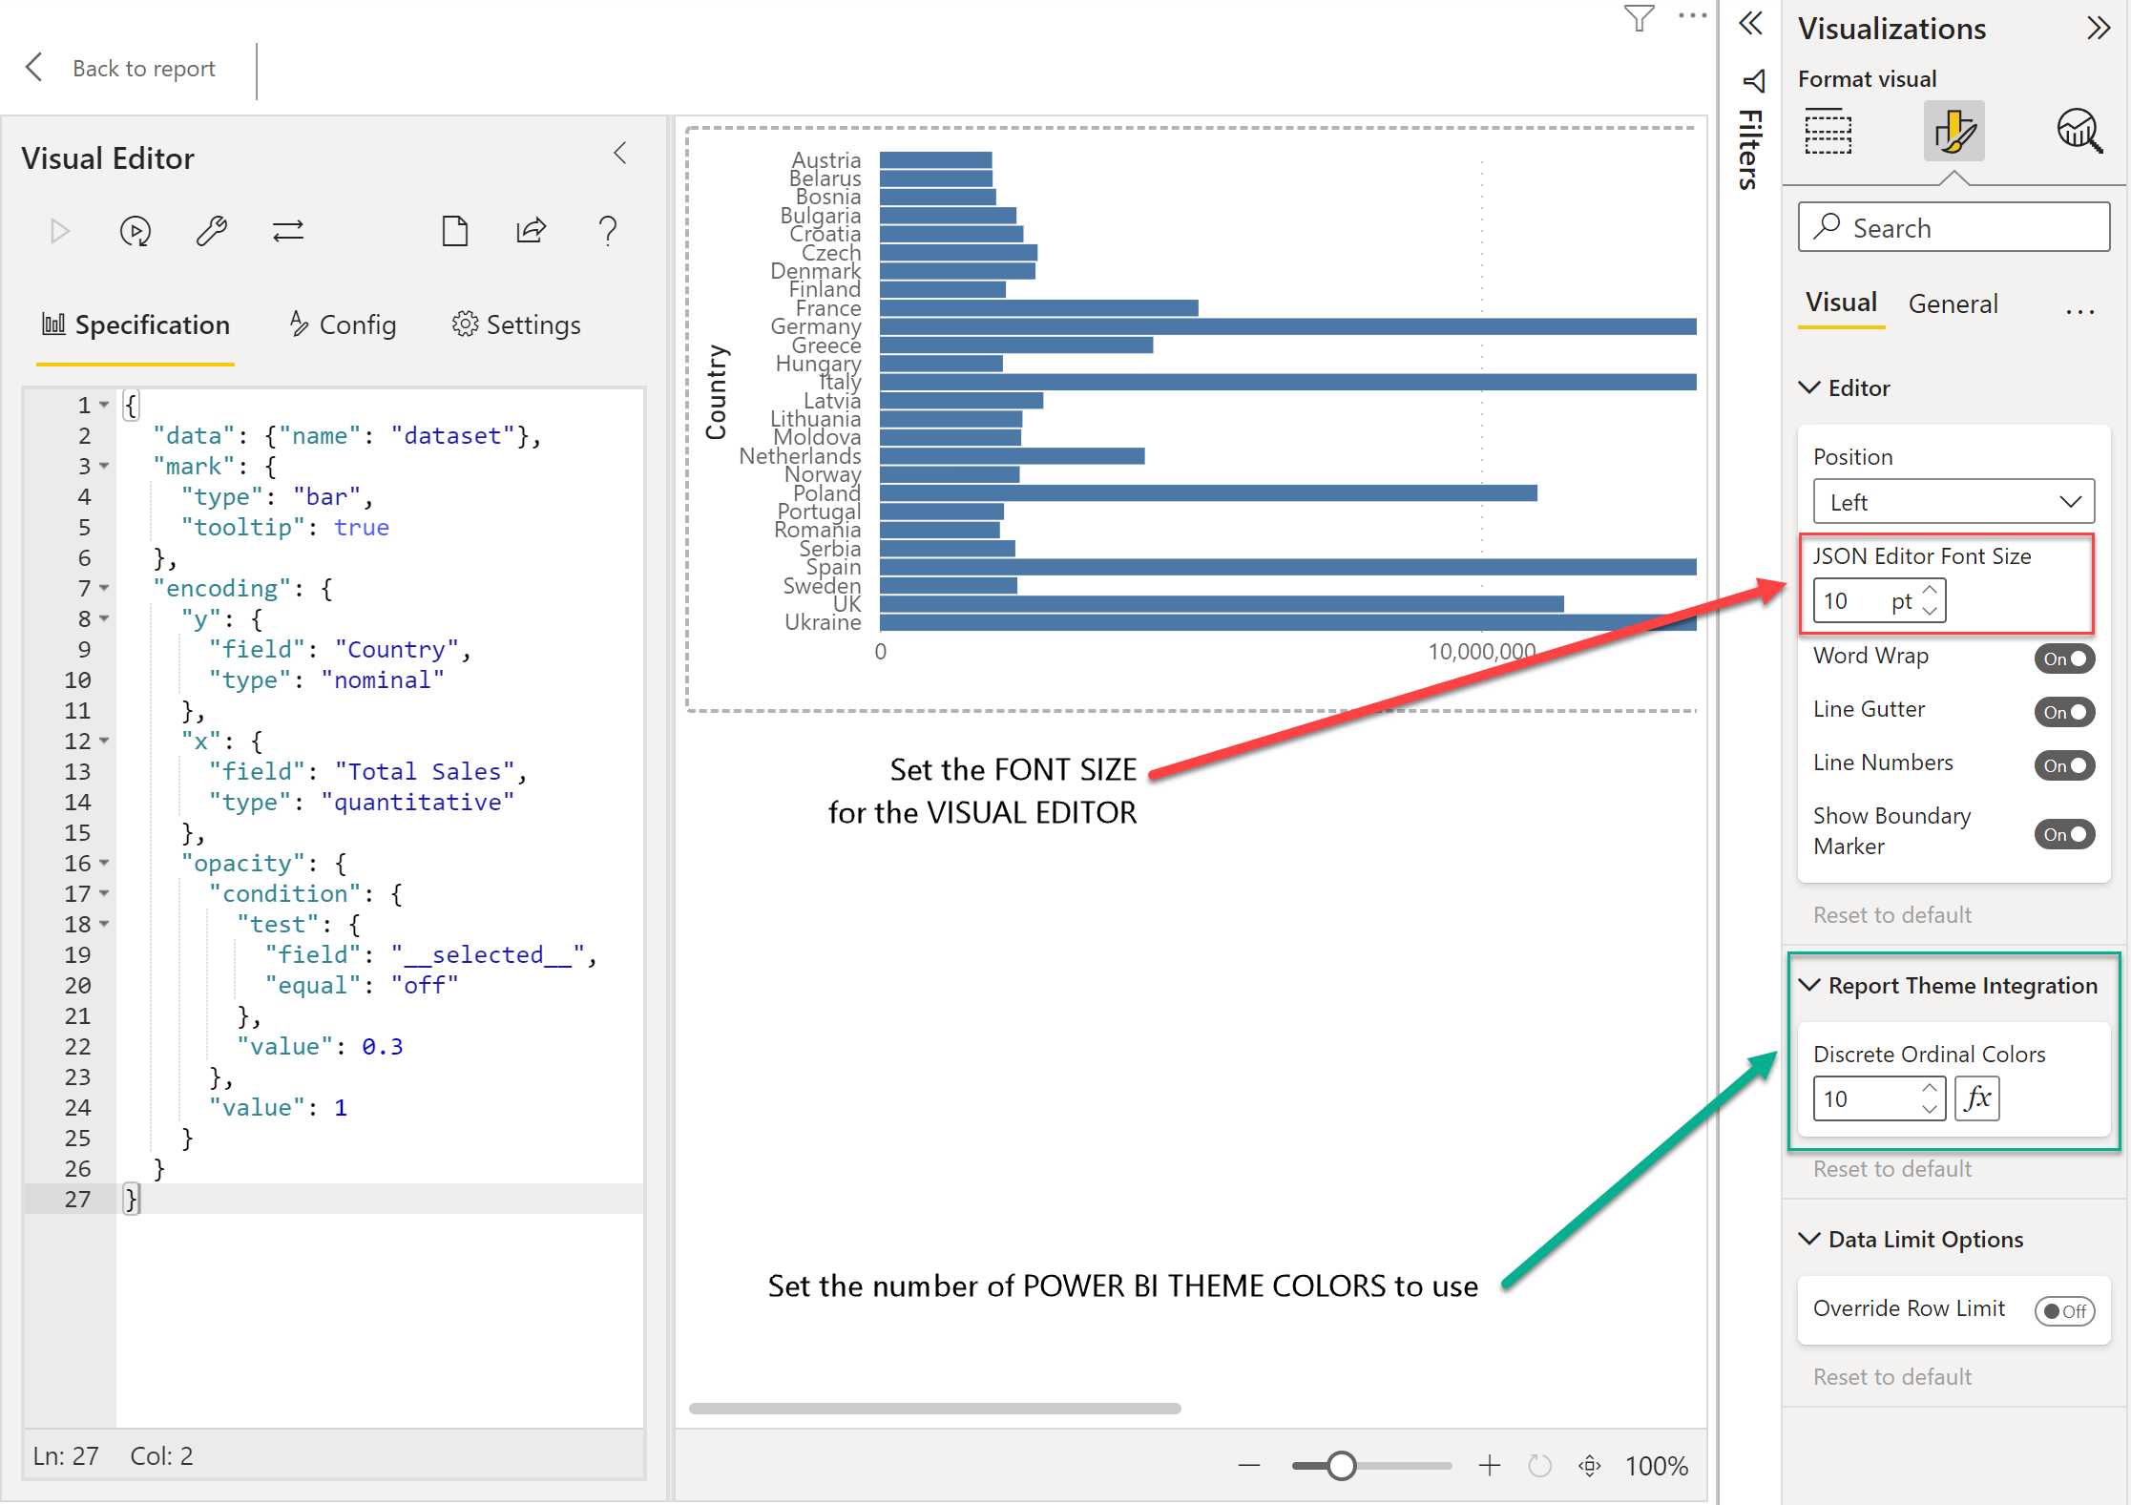
The Deneb Interface (6/6)
Properties Pane
EMPOWERING POWER BI USERS
TO CHANGE THEIR WORLD
Notes:
*** SETUP ***
Set desktop background to black
(don’t worry about taskbar clock & weather widget – will blur during video editing)
Turn off Skype notifications
Open PowerPoint
Open Chrome to Deneb website: “Deeper Concepts \ Color Schemes \ Managing via Properties” section
https://deneb-viz.github.io/schemes#managing-via-properties
Open Chrome to Deneb website: “Getting Started \ Dataset \ Data Row Limits” section
https://deneb-viz.github.io/dataset#data-row-limits
Open Power BI to THEORY pbix
< VIDEO NOTES >
The PROPERTIES pane
In the properties area, you can
Adjust the JSON EDITOR FONT SIZE; this setting is specific to a particular visual, and can thus vary between different PBIX files or even between different Deneb visuals in the same PBIX file
<<< DEMO IN POWER BI >>>
Adjust the number of Power BI Theme Colours to use, and the viewer is referred to the Deneb website for full details.
(See the Deeper Concepts \ Color Schemes \ Managing via Properties section of the Deneb website for more details)
<<< DEMO IN CHROME >>>
Override the default 10,000-row limit on the Deneb visual
(See the Getting Started \ Dataset \ Data Row Limits section of the Deneb website for more details)
<<< DEMO IN CHROME >>>
OK, that’s it for the Deneb interface. Let’s move on. I’ll see you in the next module.
< DONE >

Slide 12
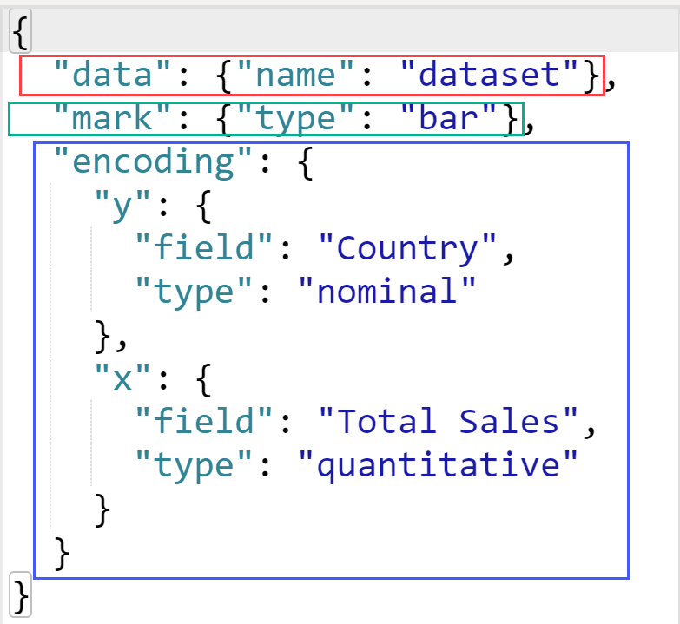
D/VL Code Blocks – Simple
Data block
In Deneb in Power BI, will always be “dataset”
Mark block
bar, arc, line, area, circle, point, text, etc.
rule, rect, square, tick, trail, etc.
Others (error band, box plot, etc.)
Encoding block
How DATA is mapped (or encoded) to MARKs
e.g., create a Y “binding” for each Country)
Colour, sorting, text, etc.
EMPOWERING POWER BI USERS
TO CHANGE THEIR WORLD
Notes:
*** SETUP ***
Set desktop background to black
(don’t worry about taskbar clock & weather widget – will blur during video editing)
Turn off Skype notifications
Open PowerPoint
Open Chrome to Vega-Lite website: Documentation \ Mark
Open Power BI THEORY pbix
< VIDEO NOTES >
Hi everyone, Greg Philps here. In this module, we’ll talk about some of the required text blocks that are included in a D/VL JSON specification. These code blocks can be roughly split into 2 groups, SIMPLE and ADVANCED. We’ll discuss each group separately.
The SIMPLE code blocks include:
The DATA block
The MARK block; and
The ENCODING block
The DATA block (shown here enclosed in a RED rectangle), when used with data provided by Power BI, will always have the same format, namely
"data": {"name": "dataset"}
Here, my interpretation is that the name of the object provided by Power BI that holds the data is DATASET, and DENEB assigns it to the DATA object.
The MARK block (shown here enclosed in a GREEN rectangle) is where one describes the type of building block that the visual will use. There are several different marks available in the VEGA-LITE language, and some of the commonly-used ones are bar, arc, line, area, circle, point, text, and many others. The viewer is referred to the MARK subsection of the DOCUMENTATION section of the VEGA-LITE website for full details.
https://vega.github.io/vega-lite/docs/mark.html
The ENCODING block (shown here enclosed in a BLUE rectangle) is used both:
To bind data to marks, and
To describe how the data should be presented
Now let’s take a look at these simple code blocks in action.
<<< DEMO >>>
Open Power BI THEORY pbix to the HOME page
Edit the Deneb bar chart visual
Here we see the standard DATA code block; as far as I know, and as noted previously, this will be common to all Deneb visuals within Power BI
Next, we have the MARK code block, in this case we are designating that we’d like to compose our visual with the BAR mark and enable tooltips
Finally, we have the ENCODING code block, where we bind the Y value of the visual to the COUNTRY field from the DATA, and we bind the X value of the visual to the TOTAL SALES field from the DATA; further, we designate that the Y axis will be of type NOMINAL, while the X axis will be of type QUANTITATIVE
As an aside, there are 4 types of field mappings used in VEGA-LITE; in addition to the NOMINAL and QUANTITATIVE types we’ve seen already, there are TEMPORAL and ORDINAL types as well. In all cases, the type describes the level of measurement that should be applied to the data:
NOMINAL is one of the most commonly-used types, and can be thought of as the CATEGORY of the data
QUANTITATIVE as well is one of the most commonly-used types, and represents the VALUE of the data
TEMPORAL is also one of the commonly-used types, and is used whenever the category of the data is DATE based
ORDINAL is less commonly used, and represents a ranked order (1st, 2nd, etc.) by which data can be sorted (this differs from quantitative data in that there is no notion of relative degree of difference between the data values)
Another way to think of which type to use is that
Use NOMINAL if the data is a string
Use QUANTITATIVE if the data is a number
Use TEMPORAL if the data is a date time object
Now, let’s move on to some of the ADVANCED code blocks.
< GO TO NEXT SLIDE >

Slide 13
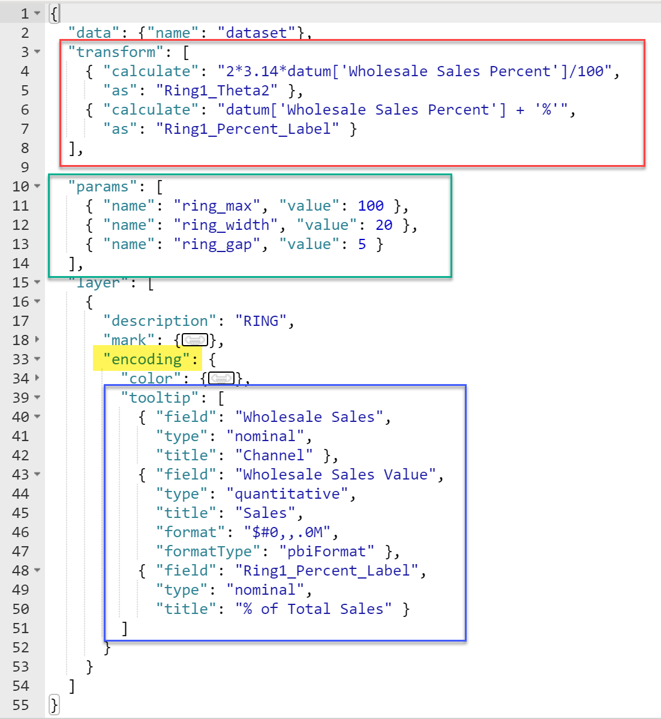
D/VL Code Blocks – Advanced
Transform block
Extend the dataset with new fields
Can be thought of as a “calculated column” for a visual
Parameter block
Enhance the visual with new calculations
Tooltip block
Extend the visual with custom tooltips
Can use D3 or Power BI formatting
Opacity block
Extend the Deneb visual to display cross-filtering in the same manner as Power BI
Expressions
Extend the visual with dynamic values instead of static fields
EMPOWERING POWER BI USERS
TO CHANGE THEIR WORLD
Notes:
*** SETUP ***
Set desktop background to black
(don’t worry about taskbar clock & weather widget – will blur during video editing)
Turn off Skype notifications
Open PowerPoint
Open Power BI PRACTICE pbix
< VIDEO NOTES >
<<< CONTINUES FROM LAST SLIDE >>>
ADVANCED code blocks are optional blocks and can be included in a D/VL JSON specification to enhance your visual. As well, you can use EXPRESSIONS to perform calculations and extend your visual.
So, some code blocks of interest are:
The TRANSFORM block
Here we can extend the dataset by creating new columns or fields
Another way to think of this, as has been noted by others, is that you can use this to effectively create visual-level calculated columns
So, to create a new column, one uses the CALCULATE keyword to identify the calculation and the AS keyword to name the new dataset column, or field
The PARAMETERS, or PARAMS block
Here we can create named PARAMETERS to enhance the display of our visual; 2 of the ways I’ve found to define parameters are to assign specific values or use EXPRESSIONS to perform calculations
The TOOLTIP block
Daniel Marsh-Patrick has added a custom TOOLTIP handler to DENEB, and here we can specifically identify not only the fields that we want to display in our tooltip, but also the title, sorting, and formatting. The formatting options include the base D3 formatting strings available in VEGA-LITE, and Power BI-specific format strings enabled by the PBIFORMAT format type
The OPACITY block
Daniel Marsh-Patrick has also added a custom OPACITY code block to DENEB, and in concert with a special field __SELECTED__ that Daniel has added to each row of the visual (e.g., bar in a bar chart), one can mimic the visual effect of a SELECTED object vs. an UNSELECTED object (for example, by control-clicking several “BARs”) (that is, continue to display the SELECTED object(s) in normal colour while increasing the transparency [or decreasing the opacity] of the UNSELECTED object(s))
<<< DEMO >>>
Open Power BI PRACTICE pbix to the HOME page
Look at the code in the KPI DONUT CHART to see examples of the TRANSFORM, PARAMS, and TOOTIP blocks
Look at the code in the SIMPLE BAR CHART to see an example of the OPACITY code block (then click a few bars to demonstrate)
OK, so that’s it for an initial review of some of the common code blocks in the D/VL languages. We’ll move onto view composition in the next module.
< DONE >

Slide 14
View Composition
Layering
Overlapping visuals that use the same set of axes (LAYER)
Vega-Lite takes care of exact alignment, in contrast to manually-layered Power BI visuals
Concatenation
Visuals can be concatenated vertically (VCONCAT)
Visuals can be concatenated horizontally either specifically oriented (HCONCAT) or can wrap to the available space (CONCAT)
Faceting
A series of similar visuals, each presenting a subset of the data (FACET)
Like the small multiples available for many standard Power BI visuals
Repeating
Like Faceting, but a full dataset is provided to each visual (REPEAT)
A view (or visual) is created for each entry in an array of fields
EMPOWERING POWER BI USERS
TO CHANGE THEIR WORLD
Notes:
*** SETUP ***
Set desktop background to black
(don’t worry about taskbar clock & weather widget – will blur during video editing)
Turn off Skype notifications
Open PowerPoint
< VIDEO NOTES >
Hi everyone, Greg Philps here. We’ve seen how one can create single visuals easily in D/VL. One of the outstanding features, however, of VEGA-LITE is its ability to create composite visuals (i.e., layered or multi-view visuals). When we first discussed VEGA-LITE in an earlier module, we noted that multiple MARKs may be combined to compose the desired visual, and the 4 different types of view composition in VEGA-LITE are:
LAYERING
Overlapping visuals that use the same set of axes
(VL takes care of the alignment of axes, whereas in standard Power BI visuals it is up to the developer to ensure alignment.)
CONCATENATION
Vertically or horizontally concatenating two or more visuals (VCONCAT or HCONCAT)
Wrapped visuals (CONCAT)
FACETING
A series of similar visuals, each presenting a subset of the data
Another way of describing FACET-ED visuals is that they are similar to the small multiples available for many Power BI visuals
REPEATING
Also a series of similar views like FACETING, but this time a full dataset is provided to each visual; the only difference is that a view is created for each entry in an array of fields
We’ll see some examples of Deneb visuals that use view composition later in the course. Let’s move on to the next module.
< DONE >

Slide 15
Colours (1/2)
Named
“red”, “green”, “blue”, “black”, “white”, and many others
Test to ensure colours display as intended
HEX codes
“#FF0000”, “#00FF00”, “#0000FF”, “#000000”, “#FFFFFF”, etc.
Can be made easier by assigning the HEX code to a parameter, then using the parameter name in your code
VL
Vega-Lite provides a set of pre-defined, named colour schemes for easy use
EMPOWERING POWER BI USERS
TO CHANGE THEIR WORLD
Notes:
*** SETUP ***
Set desktop background to black
(don’t worry about taskbar clock & weather widget – will blur during video editing)
Turn off Skype notifications
Open PowerPoint
Open Chrome to VEGA website to Documentation \ Schemes
Open Notepad++ to DENEB SNIPPETS 00 – COLOURS.xml
Open Power BI to DEMO – DENEB – THEORY.pbix
< VIDEO NOTES >
Hi everyone, Greg Philps here. In this module, we’ll go over some of the ways you can assign colours in D/VL. We’ll discuss 4 methods:
NAMED colours
HEX codes
VEGA-LITE colour schemes; and
POWER BI THEME colours as exposed by DENEB
Let’s look at each method individually:
NAMED:
You can use named colours in your code, like “red”, “green”, “blue”, “black”, “white”, etc.
Essentially any colour that can be named can be used
I was not able to find consensus on the internet regarding colour names, and so use only a small subset of common colour names in my development
As is the case with any development effort, the onus is on the developer to try-out each named color to confirm it displays as intended
I often use colours that stand-out (i.e., “red”) in my Deneb visuals to denote interim results that need further development, or, in the case I want white text on a dark background, set all text to “red” until the background colour is set, then I’ll change the text color to “white”
HEX:
You can use HEX codes in your code, like “#FF0000”, “#00FF00”, “#0000FF”, “#000000”, “#FFFFFF”, etc.
Can be made easier by assigning the HEX code to a parameter, then using the parameter name in your code
<<< DEMO >>>
Open Power BI THEORY pbix;
Create a new page
Create a DENEB visual;
Add REGIONS[COUNTRY] and MEASURES\BASE\[TOTAL SALES]
Edit and use SIMPLE BAR CHART template
Add PARAMS block to create PARAMETER for HEX code colour
Add COLOR block to ENCODING block to use PARAMETER for HEX code colour
VEGA-LITE COLOUR SCHEMES:
From the Vega-Lite website, VEGA-LITE “… provides a set of named color palettes as a scale range for the color channel …”
What this means is that you can use pre-defined named color schemes (or palettes) with your visual;
For a list of available VEGA-LITE colour schemes (which use the same named schemes as VEGA), refer to the VEGA documentation/website at
https://vega.github.io/vega/docs/schemes/
https://vega.github.io/vega/docs/schemes/#:~:text=Cyclical-,Categorical%20Schemes,-Categorical%20color%20schemes
<<< DEMO >>>
Open Power BI THEORY pbix;
Go to the new page created earlier
In the DENEB visual;
Add REGIONS[COUNTRY] and MEASURES\BASE\[TOTAL SALES]
Edit and use SIMPLE BAR CHART template
Delete the PARAMS block to create PARAMETER for HEX code colour
Delete the COLOR block from the ENCODING block to use PARAMETER for HEX code colour
Add the COLOR block to the ENCODING block to use a VEGA-LITE COLOUR SCHEME
Turn ON AUTO-APPLY
Change the SCHEME to DARK2, SET1, SET2
< GO TO NEXT SLIDE >

Slide 16
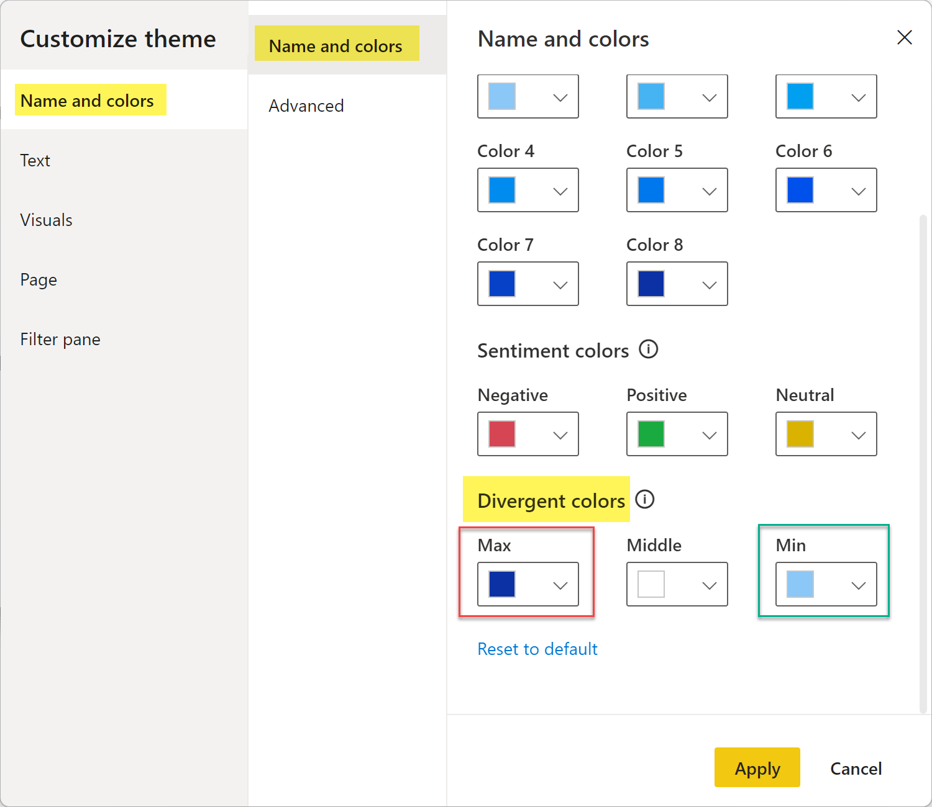
Colours (2/2)
Deneb v1.1+ provides 4 integrations with the current Power BI theme:
pbiColorNominal
Matches the current theme colours
pbiColorOrdinal
Uses a ramped scale from the MAX to MIN divergent colour of the current theme, and EXCLUDES the MIDDLE colour
pbiColorLinear
Uses an interpolated gradient from the MAX to MIN divergent colour of the current theme, and EXCLUDES the MIDDLE colour
pbiColorDivergent
Same as pbiColorLinear, but INCLUDES the MIDDLE colour
EMPOWERING POWER BI USERS
TO CHANGE THEIR WORLD
Notes:
*** SETUP ***
Set desktop background to black
(don’t worry about taskbar clock & weather widget – will blur during video editing)
Turn off Skype notifications
Open PowerPoint
Open Chrome to Deneb Website to Deeper Concepts \ Color Schemes
Open Power BI to DENEB SAMPLE pbix
< VIDEO NOTES >
<<< CONTINUED FROM LAST SLIDE >>>
POWER BI THEME colours as exposed by DENEB v1.1 and above
Deneb v1.1 introduced an integration with the theme used in a Power BI report, and offers 4 ways of interacting with the in-use theme; let’s just have a look at the sample Power BI file available when adding the custom visual
<<<DEMO >>>
Open Power BI to the Deneb Sample PBIX
Go to the COLOR SCHEMES page
Change a few color schemes
pbiColorNominal
Matches the current Power BI theme colours
pbiColorOrdinal
Uses a ramped scale from the MAX and MIN colours of the DIVERGENT COLOURS of the current Power BI theme, and excludes the MID colour
pbiColorLinear
Uses an interpolated gradient from the MAX and MIN colours of the DIVERGENT COLOURS of the current Power BI theme, and EXCLUDES the MID colour
pbiColorDivergent
Uses an interpolated gradient from the MAX and MIN colours of the DIVERGENT COLOURS of the current Power BI theme, and INCLUDES the MID colour
The viewer is directed to the DENEB website for full details.
https://deneb-viz.github.io/schemes
OK, that’s a quick discussion of some of the colour options when using D\V-L, and that’s it for the THEORY modules in this course. Next, we’ll move on to the PRACTICE modules.
< DONE >

Slide 17
Bar and Column Charts
Probably the simplest Deneb visual
Can easily replicate the standard Power BI stacked bar chart
Use BAR mark for base visual
Use TEXT mark to add data label
Use ENCODING to add sorting
To render as a stacked bar chart, add the subcategory field, add the SUM aggregate property to the X ENCODING, and add a COLOUR block
To render as a 100% stacked bar chart, add the STACK – NORMALIZE property to the X ENCODING
To convert a BAR chart to a COLUMN chart
Exchange X and Y in the ENCODINGS
Set angle for x-Axis label
EMPOWERING POWER BI USERS
TO CHANGE THEIR WORLD
Notes:
*** SETUP ***
Set desktop background to black
(don’t worry about taskbar clock & weather widget – will blur during video editing)
Copy PowerPoint and XML snippets to (and open from) C:\Temp\Deneb Course
Turn off Skype notifications
Open PowerPoint
Open Power BI to PRACTICE pbix
Open Notepad++ to Deneb Snippets 01 – Bar Charts.xml
< VIDEO NOTES >
Hi everyone, Greg Philps here. Probably the simplest of the Deneb charts is the BAR CHART. A little generic, perhaps, but nonetheless useful to begin our practical exploration of Deneb. So here’s where we’re going: <<<DEMO BAR CHARTS – 1 page >>> we have a standard Power BI stacked bar chart on the left, and a Deneb version on the right. Let’s build both from scratch to demonstrate D/V-L.
So, let’s duplicate the BAR CHART – 1 page, delete both visuals, then begin again.
<<< DEMO >>>
Open Power BI [Demo – Deneb – Practice], go to the [Bar Charts - 1] page
Duplicate the page, then delete both existing visuals
Add a POWER BI VISUAL (STACKED BAR CHART), and drop the REGIONS[COUNTRY] column into the Y-AXIS well and the MEASURES\BASE\[TOTAL SALES] measure into the X-AXIS well
Turn on data labels
(We see that Power BI has automatically sorted the visual DESCENDING by TOTAL SALES, and has automatically formatted the data labels)
Add a DENEB visual and add the REGIONS[COUNTRY] column and the MEASURES\BASE\[TOTAL SALES] measure into the VALUES well
Edit the specification, and choose the EMPTY template
Change MARK to BAR
Add ENCODING block
Add Y field = Country, type = NOMINAL
Add X field = Total Sales, type = QUANTITATIVE
Add the DATA LABELS
Add LAYER block above BAR mark
Move BAR mark into LAYER block
Add TEXT mark below BAR mark
Additional options
To sort by [Total Sales] descending,
Move Y ENCODING above layer
Add SORT block to Y ENCODING block
To format the data labels, add FORMAT/FORMATTYPE
To use gradient colours, add ENCODING & COLOR blocks to the BAR mark
To add a title, add TITLE block
So that’s a quick review of creating a bar chart from scratch in Deneb. You can also get a jump-start on the development of your visual by using the built-in SIMPLE BAR CHART specification provided in the Deneb interface, so let’s just have a quick look:
<<< DEMO >>>
Open Power BI [Demo – Deneb – Practice], go to the [Bar Charts - 2] page
Delete the existing Deneb visual
Add a DENEB visual and add the Regions[Country] column and the [Total Sales] measure into the VALUES well
Edit the specification, and choose the SIMPLE BAR CHART template
Map COUNTRY to CATEGORY
Map TOTAL SALES to MEASURE
(The SIMPLE BAR CHART template was updated in Deneb v1.2, so we’ll just replace this with simple JSON that gives the same results but is easier to read.)
If you want to STACK the bars by subcategory, add the subcategory field, alter the X ENCODING, and add a COLOUR block.
<<< DEMO >>>
Open Power BI [Demo – Deneb – Practice], go to the [Bar Charts - 2] page
Delete the existing DENEB visual
Add a DENEB visual and add the Regions[Country] column and the [Total Sales] measure into the VALUES well
Edit the specification, and choose the SIMPLE BAR CHART template
Map COUNTRY to CATEGORY
Map TOTAL SALES to MEASURE
Add the CHANNELS[CHANNEL] to the VALUES well
Change the X encoding to use the SUM aggregate
Add the COLOR block
(We see that VEGA-LITE has automatically added a LEGEND)
If you want to change the BAR chart to be a 100% BAR chart, simply add the STACK / NORMALIZE property to the BAR mark.
<<< DEMO >>>
Open Power BI [Demo – Deneb – Practice], go to the [Bar Charts - 2] page
Add a STACK / NORMALIZE property to the X ENCODING
Next, let’s look at the COLUMN CHART. This is just a slight variation on a BAR CHART, so we can reuse the BAR mark.
As a basis for development, let’s use the stacked column chart standard visual in POWER BI, and add COUNTRY to the X-Axis and TOTAL SALES to the Y-Axis.
<<< DEMO >>>
Open Power BI, go to the [Practice - Column Charts] page
Here we see a standard POWER BI STACKED COLUMN CHART, with the REGIONS[COUNTRY] column in the X-AXIS well and the [TOTAL SALES] measure in the Y-AXIS well
We also see a COUNTRY slicer with a few countries selected (France, Germany, Italy, etc.)
Delete the existing DENEB visual and add a new DENEB visual and add the Regions[Country] column and the [Total Sales] measure into the VALUES well
Edit the specification, and choose the EMPTY template
(increase the FONT SIZE for the EDITOR in the PROPERTIES PANE)
Use the JSON snippet from STACK (1) [or COLUMN (1)] that we’re already familiar with
All we have to do to turn this into a COLUMN CHART is to exchange X and Y in the ENCODING block
Set the X-axis LABEL ANGLE to 0 in the X ENCODING block
Add the sorting to the X ENCODING (reuse the same JSON code we used earlier to set the sorting)
So, really, as you see, the process for a COLUMN chart is almost exactly the same as it is for a BAR chart, and we only need to exchange the X and Y values and set the X-axis label angle.
OK, let’s move on to the next module.
< DONE >

Slide 18
Line and Area Charts
Add COLOR to convert single line into component categories
Add INTERPOLATE to set line smoothing
Add TENSION to adjust smoothing
Easily change to AREA mark
Add GRADIENT to adjust coloring
Easily change to TRAIL mark
EMPOWERING POWER BI USERS
TO CHANGE THEIR WORLD
Notes:
*** SETUP ***
Set desktop background to black
(don’t worry about taskbar clock & weather widget – will blur during video editing)
Copy PowerPoint and XML snippets to (and open from) C:\Temp\Deneb Course
Turn off Skype notifications
Open PowerPoint
Open Power BI
< VIDEO NOTES >
Hi everyone, Greg Philps here. Another of the common chart types is the LINE CHART. D/VL provides many options for dealing with line charts, and we’ll go through a few of them here.
Here we see a standard Power BI line chart and a Deneb line chart, both using the same fields. To make it a bit easier to see, I’ve once again used a COUNTRY slicer to select only a few countries (i.e., France, Germany, Italy, and Spain).
Let’s delete both charts and start from scratch.
<<< DEMO >>>
Open Power BI [Demo – Deneb – Practice], go to the [Line Charts - 1] page
Add a standard LINE CHART
Add DATES[DATE] to the X-AXIS,
Add MEASURES[Q1 2021 SALES] to the Y-AXIS
Add REGIONS[COUNTRY] to the LEGEND.
To speed-up our Deneb development a bit, let’s take a copy of the Power BI visual and change it to a Deneb visual. (That way, we get the already-selected columns and measures, as well as the filter criteria.)
Edit the Deneb visual, choose the EMPTY specification
Add LINE mark
(we don’t see anything yet)
Add encoding: X – DATE, temporal
Add encoding: Y – 2021 Q1 SALES, quantitative
(now we see a single line; before we change it to display separate lines for each country, let’s collapse the FIELDS and VISUALIZATION panes to give us more room)
Add encoding: COLOR – COUNTRY, nominal,
Add integration with Power BI theme: SCALE – SCHEME pbiColorNominal
Filter the visual to a single country
Use the FILTER pane to select only GERMANY
Add a PARAMETER block to create screen input widget for line interpolation (smoothing) options
Delete 2021 Q1 SALES measure and add 2021 JANUARY SALES measure
Add PARAMS block
Add INTERPOLATE to LINE mark
Select LINEAR, then MONOTONE, then NATURAL, then back to LINEAR
No let’s move on to the AREA mark.
<<< DEMO >>>
Open Power BI [Demo – Deneb – Practice], go to the [Line Charts - 1] page
Duplicate the [Line Charts-1] page, then delete the COUNTRY slicer and the standard POWER BI line chart; adjust the size of the DENEB visual to fill the page
Change the mark type from LINE to AREA
Again use INTERPOLATE screen input widget
Select LINEAR, then MONOTONE, then NATURAL, then back to LINEAR
Add and use TENSION screen input widget
Select CARDINAL interpolation
Select 1 (full tension); 0 (zero tension)
Remove COLOUR from ENCODING
Add LINE COLOUR and GRADIENT colour to AREA mark
TRAIL mark
Remove PARAMS block
Remove INTERPOLATE, TENSION, LINE COLOUR, and COLOUR from AREA mark
Change AREA to TRAIL mark
Add MEASURES[2021 JANUARY SALES] field
Add SIZE block
So that’s a quick showcase of some of the features of LINE, AREA, and TRAIL marks in D/VL. Hopefully you saw how small changes to the VL code resulted in big changes to the visual. We’ll see you in the next module.
< DONE >

Slide 19
Heat Maps
Use RECT mark
Adjust X-axis label angle to horizontal
Adjust X-axis position to top
Adjust space between RECT marks (PADDING)
Add FILL colour
Adjust SIZE of RECT mark
EMPOWERING POWER BI USERS
TO CHANGE THEIR WORLD
Notes:
*** SETUP ***
Set desktop background to black
(don’t worry about taskbar clock & weather widget – will blur during video editing)
Copy PowerPoint and XML snippets to (and open from) C:\Temp\Deneb Course
Turn off Skype notifications
Open PowerPoint
Open Power BI
< VIDEO NOTES >
Hi everyone, Greg Philps here. Another type of chart that is commonly used is the HEAT MAP. Heat Maps can be easily created in D/VL using the RECT mark.
Before we get going with our Deneb development, let’s do a little setup in Power BI. We’ll duplicate the page and delete the existing DENEB visual so we can start from scratch. So what we’re left with are the 2 slicers: a single-select slicer for YEAR and a multi-select slicer for COUNTRY.
<<< DEMO >>>
Open Power BI [Demo – Deneb – Practice], go to the [Heat Maps] page
Duplicate the [HEAT MAPS] page, then delete the DENEB visual
Add a TABLE visual and add the DATES[DAYOFMONTH] and REGIONS[COUNTRY] columns and the TOTAL SALES measure; turn off totals; add shadow
Convert TABLE to a DENEB visual
Edit the Deneb visual, choose the EMPTY specification
(Bump up the EDITOR FONT SIZE to, say, 16 pt)
Add RECT mark
Add ENCODING: x = DAYOFMONTH
Add ENCODING: y = COUNTRY
Adjust X-AXIS label angle: ENCODING / X / AXIS / LABELANGLE
Adjust X-AXIS position: ENCODING / X / AXIS / ORIENT
Adjust PADDING between RECT marks: add SCALE / BANDPADDINGINNER to CONFIG
Add FILL colour to ENCODING
NOTE that D/VL has automatically generated a legend
Can turn off by adding LEGEND / NULL
Adjust the RECT mark SIZE: Add HEIGHT and WIDTH
Use the COUNTRY slicer to add a few more countries
So that’s a quick demo of a HEAT MAP in D/VL. We’ll see you in the next module.
< DONE >

Slide 20
Circular Charts
Pie Chart
Donut Chart
KPI Donut Chart
Speedometer
EMPOWERING POWER BI USERS
TO CHANGE THEIR WORLD
Notes:
*** SETUP ***
Set desktop background to black
(don’t worry about taskbar clock & weather widget – will blur during video editing)
Copy PowerPoint and XML snippets to (and open from) C:\Temp\Deneb Course
Turn off Skype notifications
Open PowerPoint
Open Chrome to the VEGA-LITE documentation for the ARC mark
Open Power BI
< VIDEO NOTES >
Hi everyone, Greg Philps here. Another of the common chart types is CIRCULAR CHARTS. All circular charts in D/VL use the ARC mark, which has a different set of properties that impact its display than the other marks we’ve seen to date. Let’s have a quick look at the VL documentation for the ARC mark:
https://vega.github.io/vega-lite/docs/arc.html
Some of the properties of interest here are:
radius (or outerRadius) – the outer radius in pixels
radius2 (or innerRadius) – the inner radius in pixels
theta – the start arc angle in radians
theta2 – the end arc angle in radians
cornerRadius – the radius of the arc corners in pixels
<<< DEMO >>>
Open Power BI [Demo – Deneb – Practice], go to the [Circular Charts] page
So here’s where we’re going: we see a DONUT chart, a KPI DONUT CHART, and a SPEEDOMETER. Let’s start from scratch and develop each in turn. We’ll start with a simple PIE CHART in Deneb and then see how we can easily convert this into a DONUT CHART.
<<< DEMO >>>
Open Power BI [Demo – Deneb – Practice], create a new page
Add a Deneb visual, and add the CHANNELS[CHANNEL] column and the TOTAL SALES measure
Edit the Deneb visual, choose the EMPTY specification
Add ARC mark
Add ENCODING: theta = TOTAL SALES
Add ENCODING: color = CHANNEL
NOTE that D/VL has automatically generated a legend
We can add the LEGEND = NULL property to the COLOUR BLOCK to tell VL to NOT generate a legend
We can set the value of the OUTERRADIUS property to adjust the size of the PIE CHART
We can add an INNERRADIUS property and value to convert the visual into a DONUT CHART and adjust its’ value to make the donut as “thick” as we want
Now let’s take a quick look at another common use of the donut chart, namely the KPI DONUT CHART. For this, we’ll need a PERCENTAGE value, so let’s create a new Deneb visual.
<<< DEMO >>>
Open Power BI [Demo – Deneb – Practice], go to the new [PAGE 1] page
Look at the RING1_PERCENT and RING1_CATEGORY measures
Add a Deneb visual, and add the RING1_CATEGORY, RING1_PERCENT, and WHOLESALE SALES measures
Rename the measures in the VALUES well:
RING1_CATEGORY to WHOLESALE SALES
RING1_PERCENT to WHOLESALE SALES PERCENT
WHOLESALE SALES to WHOLESALE SALES VALUE
Edit the Deneb visual, choose the EMPTY specification
Add a TRANSFORM block to EXTEND the dataset by converting the PERCENT value into RADIANS
Add a PARAMETERS block to ENHANCE the visual by setting and calculating values (doing MATH)
Add a PERCENT mark
Stop and discuss what we’ve added so far:
A TRANSFORM block to convert the percent value to radians
A PARAMETERS block to do some math to calculate the ring radius and width, as well as to set the ring colour
An ARC mark using the OUTER and INNER radius we calculated in our PARAMETERS and the RADIANS value we added to our dataset; note we set THETA = 0 and THETA2 to our RADIANS value
Finally, we used the COLOUR value we set in our PARAMETERS
Add a LAYER block and move the RING mark into the LAYER
(Note there has been no change to the visual, but now the RING mark is inside the LAYER)
Add a BACKGROUND mark
Note: OPACITY block added to set the opacity (transparency) of the background ring to the value we set in our PARAMETERS block
Add ROUNDED CORNERS
We can set the value as desired, but since our ring width is 20, we’ll use half, or 10
Add TOOLTIP
Note that we can’t see the tooltip; this is because of the Z-ORDER of our marks, and we need the TOP mark to be the RING, so let’s move the BACKGROUND mark above the RING mark and try again
Add TEXT mark for PERCENT value
Add TEXT mark for CATEGORY value
So now we have our final visual that consists of 4 overlapping marks: an ARC mark for the background, another ARC mark for the ring, a TEXT mark for the percent value, and another TEXT mark for the category label.
OK, let’s move on to the SPEEDOMETER.
<<< DEMO >>>
Open Power BI [Demo – Deneb – Practice], go to the [Circular Charts] page
We can see that this is just 5 overlapping basic visuals (3 ARCs for the scale, 1 ARC for the needle, and 1 TEXT for the percent. So let’s start building.
<<< DEMO >>>
Open Power BI [Demo – Deneb – Practice], go to the new [PAGE 1] page
Add a Deneb visual
Add the RING1_PERCENT measure; rename to NEEDLE PERCENT
Choose the EMPTY specification
Edit the DENEB visual
(once again, we’ll use the PROPERTIES PANE to increase the Visual Editor FONT SIZE to 16 pt)
Once again, add a TRANSFORM block to EXTEND the dataset by converting the PERCENT value into RADIANS
(this looks more involved than the TRANSFORM used in out KPI DONUT CHART earlier, but we’re converting 4 values into radians instead of 1; the math is not important for the purposes of this course, but rather the use of the TRANSFORM block)
Once again, add a PARAMETERS block to ENHANCE the visual by setting and calculating values (doing MATH)
Add a LAYER block
Add an ARC mark for the POOR scale section
Using the RADIUS values we calculated in our PARAMETERS block and the THETA values we calculated in our TRANSFORM block
Add an ARC mark for the AVERAGE scale section
Add an ARC mark for the GOOD scale section
Add an ARC mark for the NEEDLE
Add a TEXT mark for the PERCENT
So that’s a quick showcase of some of the features of CIRCULAR CHARTS in D/VL. We saw how very similar basic code blocks can result in a variety of visuals, and we needed to make only small changes to the VL code. We’ll see you in the next module.
< DONE >

Slide 21
Linked Charts
Use a BRUSH to link 2 visuals
Example
Overview and Detail
Add an OVERVIEW area chart
Add a DETAIL area chart
Use a BRUSH to make a SELECTION in the OVERVIEW chart
Use a TRANSFORM block to FILTER the DETAIL chart
EMPOWERING POWER BI USERS
TO CHANGE THEIR WORLD
Notes:
*** SETUP ***
Set desktop background to black
(don’t worry about taskbar clock & weather widget – will blur during video editing)
Copy PowerPoint and XML snippets to (and open from) C:\Temp\Deneb Course
Turn off notifications
Open PowerPoint
Open Power BI
< VIDEO NOTES >
Hi everyone, Greg Philps here. One of the standout features of VEGA-LITE that can now be used in Power BI thanks to the DENEB custom visual is the linking of visuals. Let’s take a quick look at 2 linked visuals.
<<< DEMO >>>
Open Power BI [Demo – Deneb – Practice], go to the [Linked Charts] page
Use the brush in the top OVERVIEW area chart to make a selection that is reflected in the bottom DETAIL area chart.
So let’s develop the 2 visuals from scratch and then link them.
<<< DEMO >>>
Open Power BI to the LINKED CHARTS page
Duplicate the LINKED CHARTS page, then delete the DENEB visual
(NOTE: So now just have the YEAR slicer)
Create a new DENEB visual, and add the DATES[DATE] column and the TOTAL SALES measure
Edit the DENEB visual
Choose the EMPTY specification
Add the CONCATENATION block
OVERVIEW visual
Add the AREA mark
Set the SIZE
(Collapse the VISUALIZATION and FIELD panes)
Add the TITLE block
DETAIL visual
Add the AREA mark
Set the SIZE
Add the TITLE block
LINKING
Add a brush (or the SELECTION) to the OVERVIEW area chart
(demo how you can now use the brush)
Add a TRANSFORM block (or the FILTER) to the DETAIL area chart
So that’s how easy it is to link charts in D/VL. Let’s move on to the next module.
< DONE >

Slide 22
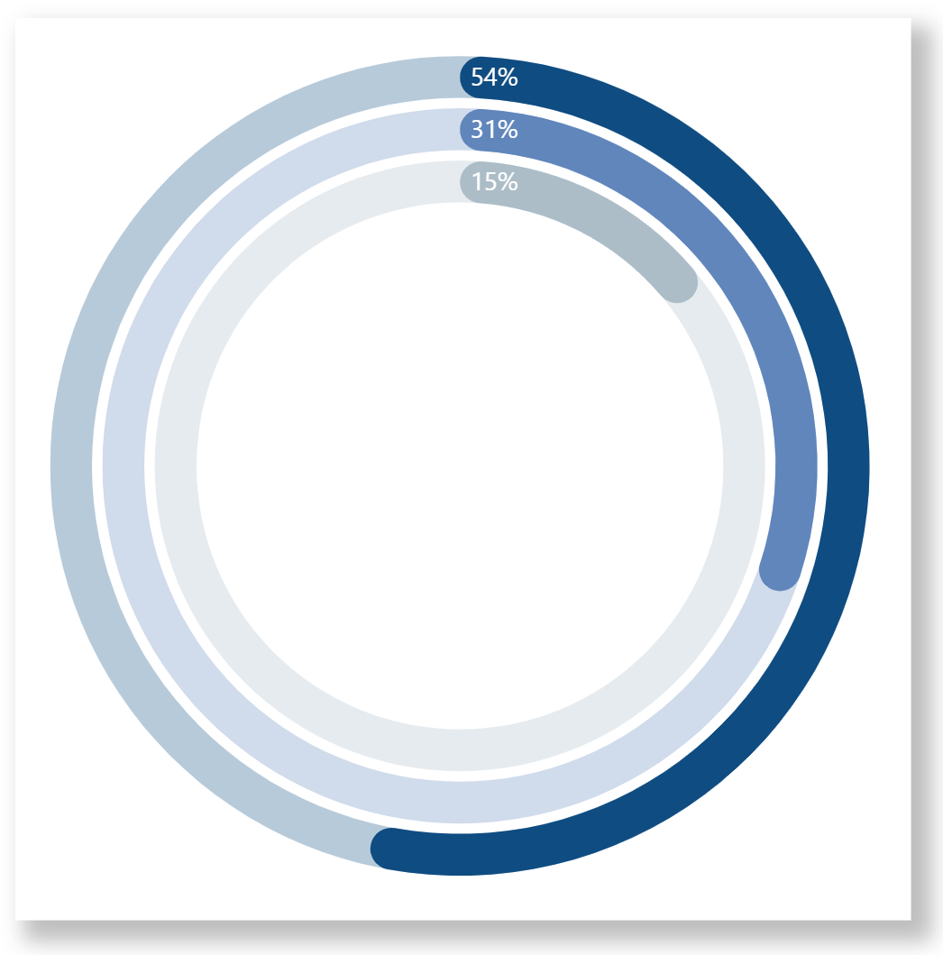
Composite Charts
A COMPOSITE chart or visual can be easily created in Deneb by layering (or overlapping) several basic marks
An example is a RING CHART, which consists of 9 overlapping marks (6x ARC and 3x TEXT)
EMPOWERING POWER BI USERS
TO CHANGE THEIR WORLD
Notes:
*** SETUP ***
Set desktop background to black
(don’t worry about taskbar clock & weather widget – will blur during video editing)
Copy PowerPoint and XML snippets to (and open from) C:\Temp\Deneb Course
Turn off Skype notifications
Turn on PowerToys \ Awake
Open PowerPoint
Open Power BI
< VIDEO NOTES >
Hi everyone, Greg Philps here. A composite visual can easily be created in DENEB by layering several MARKs on top of one-another. One example of this is a RING CHART, which we’re going to explore further here. What we’re actually looking at, if we destruct the full visual, is a series of overlapping basic charts.
Let’s start building the chart one layer at-a-time and see where we get.
Before we start, let’s just take a quick look at the measures we’ll be using.
<<< DEMO >>>
Open Power BI to the DEMO – DENEB - PRACTICE – COMPOSITE CHARTS page
Review the RING1_PERCENT, RING2_PERCENT, RING3_PERCENT measures
We see the RING1_PERCENT measure is simply dividing the WHOESALE SALES measure by the TOTAL SALES measure; and similarly for the RING2_PERCENT and RING3_PERCENT measures. OK, let’s start building.
<<< DEMO >>>
Open Power BI to the DEMO – DENEB - PRACTICE – COMPOSITE CHARTS page
Add a new DENEB visual
Add the RING1_PERCENT, RING2_PERCENT, RING3_PERCENT measures to VALUES well
Edit the visual and use the EMPTY template
Increase the editor font size to 16 pt
Add a TRANSFORM block to extend the dataset with the percentages expressed in RADIANS
Add a PARAMS block to name/calculate internal (non-data-dependent) values for the visual
Add a LAYER block
Add an ARC mark for RING1 BACKGROUND
Add an ARC mark for RING1 PERCENT
Add a TEXT marks for RING1 LABEL
Copy the 3x marks for RING1 to Notepad++ twice, search & replace for RING2 and RING3, then copy back to Power BI\Deneb
Make the RING corners rounded
OK, so that’s a quick development of 9 overlapping, or layered, marks to produce a composite visual, namely a RING chart. Let’s move on to the next module.
<<< DONE >>>

Slide 23
Example
Bar Chart – Internal Labels
Can save horizontal space by placing all labels inside the BAR
Maximize space available for BAR (which is the point of the visual anyway)
Use SIMPLE BAR CHART template to create first MARK
Turn off Y-axis
Use LAYER to allow for overlapping MARKs
Add TEXT mark (left-end) for COUNTRY
Add TEXT mark (right-end) for TOTAL SALES
EMPOWERING POWER BI USERS
TO CHANGE THEIR WORLD
Notes:
*** SETUP ***
Set desktop background to black
(don’t worry about taskbar clock & weather widget – will blur during video editing)
Copy PowerPoint and XML snippets to (and open from) C:\Temp\Deneb Course
Turn off Skype notifications
Turn on PowerToys \ Awake
Open PowerPoint
Open Power BI
< VIDEO NOTES >
Hi everyone, Greg Philps here. OK, so next let’s do a start-to-finish example of a space-saving BAR CHART with all labels inside the bars. We’ll start by duplicating the EXAMPLE – BAR CHART page, delete the existing DENEB visual, so we just have the COUNTRY slicer left.
<<< DEMO >>>
Open Power BI to the EX – BAR CHART page, then duplicate it
Note that it’s a blank page except for the COUNTRY slicer (with 7 countries selected)
Add a new DENEB visual
Add the Regions[Country] column and the [Total Sales] measure
Edit the DENEB visual and choose the SIMPLE BAR CHART template
Choose CATEGORY = COUNTRY
Choose MEASURE = TOTAL SALES
Delete the OPACITY block
Turn off the Y-Axis title
Set the sorting to DESCENDING by TOTAL SALES
Add a LAYER block
Add NAME property to BAR mark
Add country TEXT block
X = 5, can adjust for desired padding
Move Y ENCODING above LAYER block
Add total sales TEXT block
ALIGN = RIGHT, “dx” = -5, can adjust to desired padding
So there’s another example of a composite visual composed of 3 overlapping marks. Let’s move on to the next module.
< DONE >

Slide 24
Example
Gantt Chart
Create a project/task dataset with PROJECT, TASK, START DATE, END DATE, and PERCENT COMPLETE
Create a standard TABLE Power BI and add new columns
Copy-and-paste the TABLE visual and change it to a DENEB visual
Add a BAR mark for the project
Add ENCODING for the X and Y
Use an “X2” encoding to create RANGED bars
Set the COLOUR and POSITION of the TASKS
Add a LAYER around the existing MARK, then add 2 more MARKs:
a TEXT mark for the task name; and
a BAR mark for the percent completion
EMPOWERING POWER BI USERS
TO CHANGE THEIR WORLD
Notes:
*** SETUP ***
Set desktop background to black
(don’t worry about taskbar clock & weather widget – will blur during video editing)
Copy PowerPoint and XML snippets to (and open from) C:\Temp\Deneb Course
Turn off Skype notifications
Turn on PowerToys \ Awake
Open PowerPoint to this presentation
Open Power BI
Open Excel to the TASKS.xlsx workbook
< VIDEO NOTES >
Hi everyone, Greg Philps here. So let’s do another example using the Deneb custom visual, this time creating a simple Gantt chart to illustrate a few features of Vega-Lite.
So let’s put a dataset together first. I created a small dataset in Excel with PROJECT, TASK, START DATE, END DATE, and PERCENT COMPLETE columns and imported it into Power BI as the [TASKS] table. My initial thought was to do all calculations in Vega-Lite, but as I haven’t spent the time to learn how to do JavaScript date calculations properly yet, I chose the easiest path and created some calculated columns in Power BI to calculate the “END DATE” (as End2) associated with the PERCENT COMPLETION. To see the data, let’s create a standard Power BI table and add the [TASKS] data to the table.
<<< DEMO >>>
Open Excel and the TASKS.xlsx spreadsheet
Open Power BI and look at the TASKS table including the calculated columns for FULL DAYS, PERCENT COMPLETION DAYS, and END2
Duplicate the EX – GANTT CHART page, delete the DENEB visual
Copy-and-paste the TABLE visual and change it to a DENEB visual
Use FILTER PANE to select only Project ID’s 1, 2, and 3
Edit the DENEB visual
Add a BAR mark
Add an ENCODING block
NOTE: the use of the “X” and “X2” encodings to define a “RANGED” bar using the START and END fields
Add a SORT block to sort the projects
NOTE: no impact on this simple small dataset but essential for a larger, more realistic dataset
Turn off the X-axis TITLE
Colour the TASKS
Turn off the LEGEND
Use an OFFSET block to adjust the position of the project’s TASKs to be STEPPED
Add a TRANSFORM to calculate the decimal percentage (out of 100)
Add a custom TOOLTIP
Add a LAYER block; name the BAR
Move ENCODING block above LAYER block
Add TEXT mark (for task name)
Add BAR mark (for task percent complete)
NOTE the use of a second “X2” encoding (for END2) that is specific to this mark
Discuss how encodings outside of the LAYER block apply to all marks inside the block, but that they can be OVER-RIDDEN with other values as desired
This is admittedly a very simple GANTT CHART and it’s not very useful and doesn’t look that great, but it’s purpose was to showcase how easily and quickly a composite visual can be created and adjusted in D/VL until the desired layout is achieved, so hopefully it will be of some use.
Let’s move on to the next module.
< DONE >

Slide 25
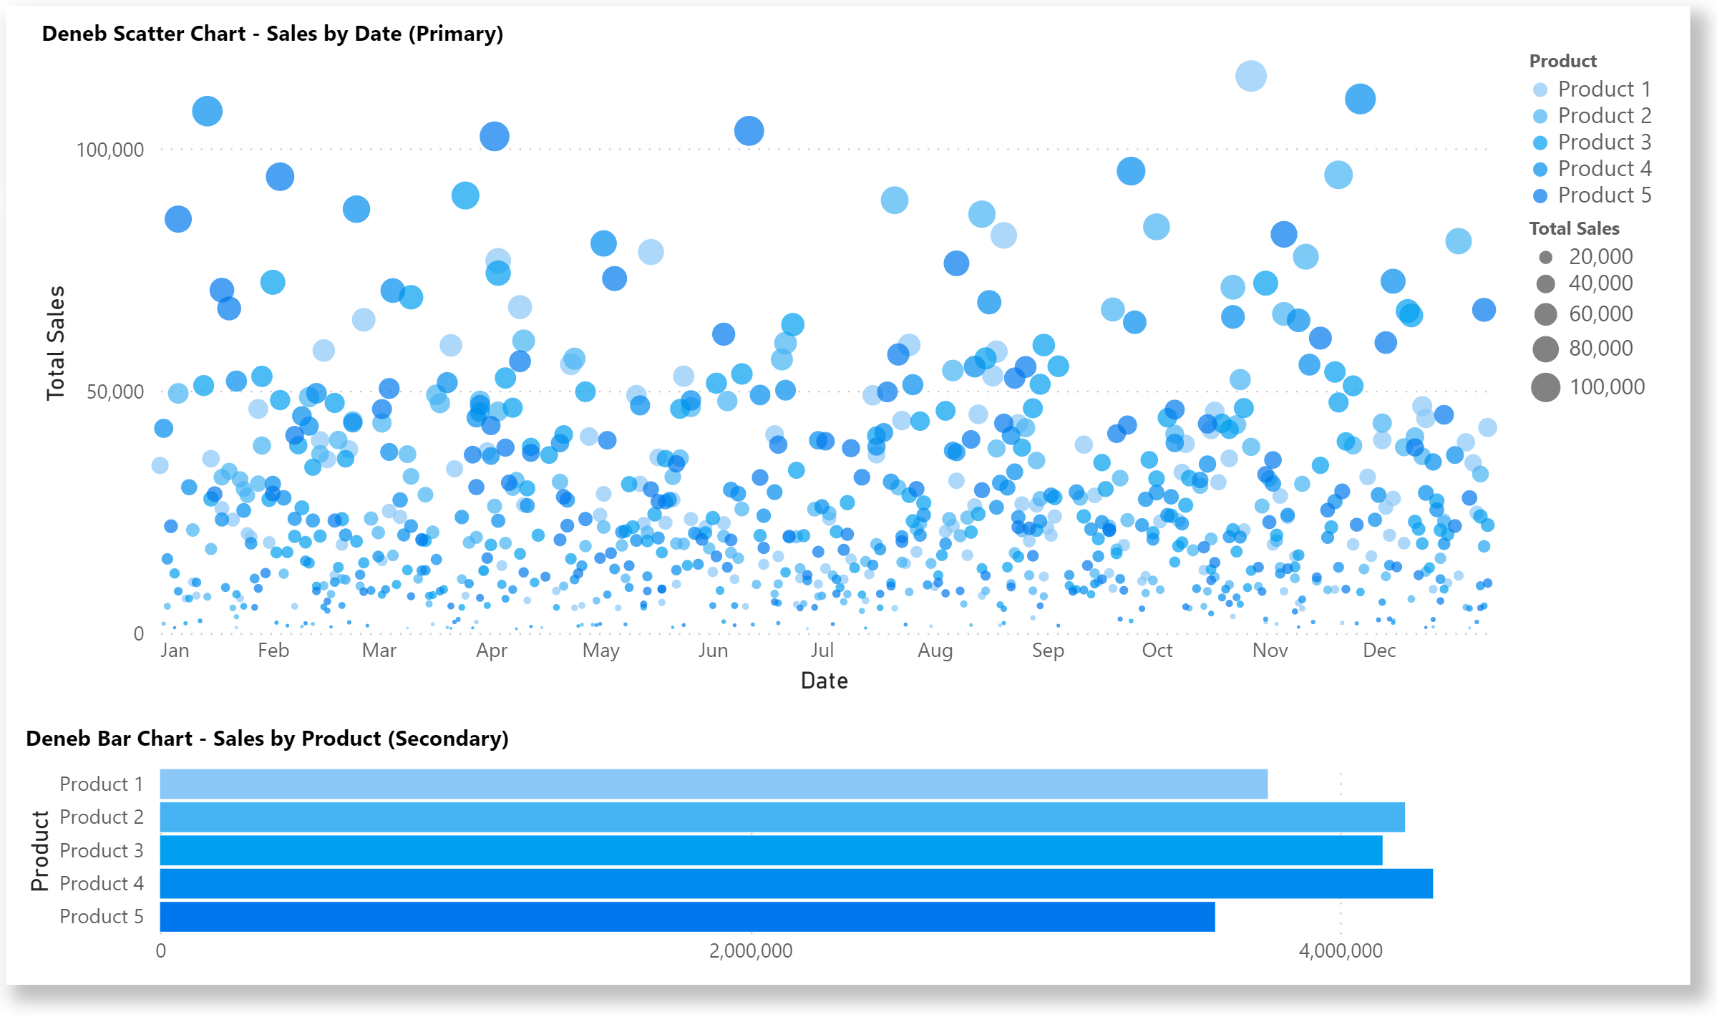
Example
Linked Charts – Scatter and Bar
Composite visual consisting of a SCATTER chart (using the POINT mark) vertically concatenated with a BAR chart (using the BAR mark)
Charts are linked with BRUSH selection in SCATTER chart filtering the BAR chart
EMPOWERING POWER BI USERS
TO CHANGE THEIR WORLD
Notes:
*** SETUP ***
Set desktop background to black
(don’t worry about taskbar clock & weather widget – will blur during video editing)
Copy PowerPoint and XML snippets to (and open from) C:\Temp\Deneb Course
Turn off Skype notifications
Turn on PowerToys \ Awake
Open PowerPoint
Open Power BI
< VIDEO NOTES >
Hi everyone, Greg Philps here. OK, so next let’s do a start-to-finish example of LINKING CHARTS, in this case a SCATTER and a BAR chart. First, let’s create a simple SCATTER CHART; this will be the primary visual in our pair of visuals.
<<< DEMO >>>
Open Power BI to the EX – SCATTER AND BAR page
Duplicate the page and delete the existing DENEB visual
So it’s now a blank page except for 2 slicers; 1 for Year (with 2021 selected) and 1 for Product (with products 1-to-5 selected)
Add a new DENEB visual, add the DATES[DATE] and PRODUCTS[PRODUCT] columns and the [TOTAL SALES] measure
Edit the DENEB visual and
Use the EMPTY template
Bump-up the VISUAL EDITOR font size to 16 pt
Add a SCATTER chart with a POINT mark in a vertical concatenation block and assign
The DATE to the X-axis
The TOTAL SALES to the Y-axis
The PRODUCT to the colour
The TOTAL SALES to the size of the point
Increase the size of the scatter chart by adding WIDTH and HEIGHT values
Adjust the X-axis values and title
Create the interaction with the Power BI theme colours by adding the SCHEME to the COLOR block
Add the TITLE block
Next, let’s add a simple BAR CHART; this will be the secondary, or dependent, visual in our linked pair.
<<< DEMO >>>
Open Power BI to the DUPLICATE EX – SCATTER AND BAR page
Edit the Deneb visual and add a BAR mark block to the vertical concatenation block and assign
The TOTAL SALES to the X-axis (note that we need to use the AGGREGATE operation of SUM)
The PRODUCT to the Y-axis
The PRODUCT to the colour and add the interaction with the Power BI theme colours with the SCHEME in the COLOR block
Set the size of the of the bar chart by adding WIDTH and HEIGHT values
Adjust the X-axis values and title
Create the interaction with the Power BI theme colours by adding the SCHEME to the COLOR block
Add the TITLE block
Now, we’re finally ready to link the primary and secondary visuals. We’ll use the primary visual to make our selections and the secondary visual will respond to our selections.
<<< DEMO >>>
Open Power BI to the DUPLICATE - EX – SCATTER AND BAR page
Edit the Deneb visual and
Add a SELECTION block to the SCATTER CHART
Add a TRANSFORM block to FILTER the BAR CHART
Let’s go back to the page and we can click-and-drag in the scatter chart and the bar chart will adjust accordingly. The same as with any standard Power BI visual we can also adjust the filters (slicers) on the page and the linked charts wil adjust accordingly.
OK, so that’s a quick development of linking 2 visuals in Deneb and Vega-Lite. Let’s move on to the next module.
< DONE >

Slide 26
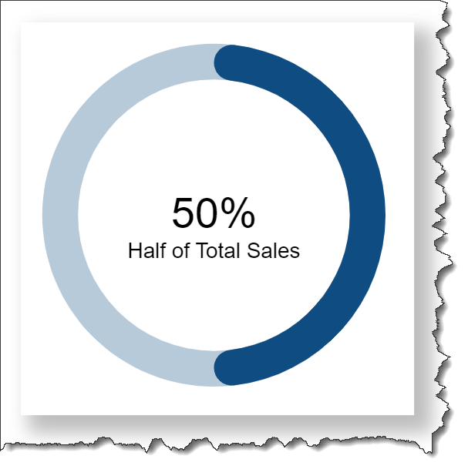
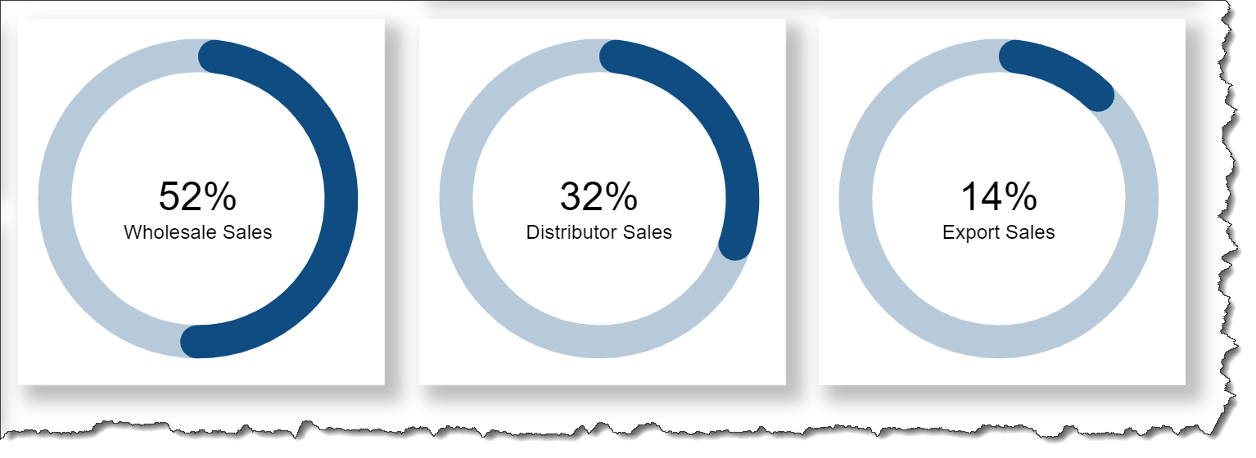
Templates
Create JSON template from Donut KPI chart
Use JSON template to create 3 new visuals
EMPOWERING POWER BI USERS
TO CHANGE THEIR WORLD
Notes:
*** SETUP ***
Set desktop background to black
(don’t worry about taskbar clock & weather widget – will blur during video editing)
Turn off Skype notifications
Turn on PowerToys \ Awake
Open PowerPoint
Open Power BI
Open File Explorer to C:\Temp\Deneb Course\Templates
Turn off Navigation Pane
Open Notepad++
Save file (deneb_templates_readme.txt) to C:\Temp\Deneb Course\Templates
< VIDEO NOTES >
Hi everyone, Greg Philps here. Next, let’s take a quick look at creating and using DENEB TEMPLATES.
To create a JSON template from an existing Deneb visual, edit the visual and click the GENERATE JSON TEMPLATE icon/button (document with an arrow) in the Deneb Visual Editor pane. You’ll be presented with a dialog where you can enhance the template before its creation, where you can:
Add basic information about the template (it’s name, description, and author name)
Adjust the names of the fields that will be presented to template users
Copy the generated template to the clipboard so it can be pasted into a new file
(I use Notepad++)
(If necessary, adjust the file extension to JSON)
To use a JSON template, create a Deneb visual, add your desired columns and measures (in our case, we’ll use the ring 1 category and percent measures), then when first EDITING the visual, choose SELECT JSON TEMPLATE from the IMPORT FROM TEMPLATE section
(If you get an error message stating that the content is not a valid Deneb template, ensure that the template does not have NAMEPLACEHOLDER line(s) in the DATASET block, then try again.)
Complete the FIELD mapping by selecting your desired columns and measures, then click the CREATE button.
Let’s use the template 2 more times for the second and third rings.
And there we go; that’s a quick demo of creating and using templates in Deneb. We’ll see you in the next module.
< DONE >

Slide 27
Visual Studio Code
You can use Visual Studio Code to develop/debug
Copy the SPECIFICATION from the Deneb visual in Power BI to VS Code
Can’t access Power BI dataset, so need to hard-code some sample DATA that is reflective of the dataset you’ll be passing in from Power BI
Iterate as necessary in VS code until you’re ready to continue development in Power BI
Copy the VS Code JSON and past back into the Deneb visual in Power BI
Reset the DATA block to interface with the Power BI data
EMPOWERING POWER BI USERS
TO CHANGE THEIR WORLD
Notes:
*** SETUP ***
Set desktop background to black
(don’t worry about taskbar clock & weather widget – will blur during video editing)
Copy PowerPoint and XML snippets to (and open from) C:\Temp\Deneb Course
Turn off Skype notifications
Open PowerPoint
Open Power BI (Practice PBIX to CIRCULAR CHARTS page)
Open Notepad++ (to C:\Temp\Deneb Course\Deneb Snippets 11 – Visual Studio Code.xml)
Open Visual Studio Code
< VIDEO NOTES >
Hi everyone, Greg Philps here. What’s also of interest is that you can use Visual Studio Code to develop your D/VL visuals. Let’s take a quick look.
First, you need an extension to view the Vega-Lite code; I’ve used the VEGA VIEWER extension in the past, and needed to add the extension to VS Code. I recently rebuilt my workstation, and when I downloaded and installed VS Code from the Microsoft Store, the VEGA VIEWER extension was already installed and available. (Not sure if this was a default configuration by Microsoft or if it was a legacy of it having been installed previously on my workstation, but anyway, it’s here.)
<<< DEMO >>>
Open VS Code, go to EXTENSIONS in the sidebar, and display the VEGA VIEWER extension
Next, let’s create a new file and save it with a [VL dot JSON] extension
Open Power BI to the CIRCULAR CHARTS page; copy the specification from the SPEEDOMETER Deneb visual
Open VS Code to the new file and paste the specification from the DENEB visual
Next, as there’s no connection to a Power BI dataset (obviously), you need to adjust the DATA section of your code
(Replace data block with the one from snippets file 11)
Then, to view the visual, you can right-click on the code tab and select PREVIEW VEGA GRAPH
(NOTE: we see that the needle position is being displayed properly but the needle value is not, as the Power BI formatting that is enabled by the Deneb custom visual is obviously not available.)
Let’s make some adjustments and we’ll see the results
Adjust the AVERAGE START PERCENT to 49, then right-click on the code tab and select PREVIEW VEGA GRAPH again
Adjust the NEEDLE PERCENT to 0.44, then right-click on the code tab and select PREVIEW VEGA GRAPH again
Adjust the colour of the ARC mark for the GOOD segment to BLUE, then right-click on the code tab and select PREVIEW VEGA GRAPH again
So that’s a quick look at using VS code to aid the development of a visual. I find the Visual Studio Code environment useful in concentration just on the VEGA-LITE code and displaying the data I’ve set manually to help me ensure I’m getting the results I expect. Once the development is complete in VS Code, I’ll copy the JSON back to POWER BI and reset the DATA block to once-again use the Power BI dataset.
< DONE >

Slide 28
Summary
For more information, be sure to check:
The DENEB website at
https://deneb-viz.github.io/
The DENEB SHOWCASE section of the ENTERPRISE DNA FORUM at:
https://forum.enterprisedna.co/c/deneb-showcase/58
Thanks for watching
EMPOWERING POWER BI USERS
TO CHANGE THEIR WORLD
Notes:
<<< IN PROGRESS >>>
*** SETUP ***
Set desktop background to black
(don’t worry about taskbar clock & weather widget – will blur during video editing)
Turn off Skype notifications
Turn on PowerToys \ Awake
Open PowerPoint
< VIDEO NOTES >
Hi everyone, Greg Philps here. So that’s it for my introduction to using the Deneb custom visual in Power BI. I think this visual has already opened-up Power BI’s ability to produce some amazing visuals, and only see a brighter future ahead, both as more and more Power BI developers create Deneb visuals and share them via templates, and as new and expanded capabilities are added to the Deneb custom visual and Vega-Lite language.
The 2 main take-aways, in my opinion, that DENEB/VEGA-LITE brings to Power BI are:
A simple visual can be built-up in stages by adding and adjusting properties, and
A complex visual is nothing more than a composite of simple visuals
For me, it’s changed the way I look at visuals, and now I see everything as composite visuals. You can pretty-much do whatever you want with D/VL, and I’ve found its easiest, when I’m developing in Deneb, to work on one MARK at-a-time until I get the results I’m looking for. Sometimes I find it easier to proceed by creating a stand-alone visual of each MARK, then combining them as necessary to achieve the desired result.
DENEB was available in version 1.1 during the development of this course, and version 1.2 came out during its recording, so I didn’t take advantage of its new features (for example, cross-highlighting support). It’s always risky to speculate on rumours of what the future holds, so take these with a grain of salt, but a few of the things that I’ve heard that may be available later this year in version 1.3 (or later versions) are:
Enhanced access to the Power BI theme colours (and shadings),
A debug pane that exposes additional information about the data in a DENEB visual, and
Displaying a PREVIEW image when using a DENEB template (available if the author has included one during generation).
For more information, be sure to check the DENEB WEBSITE and the DENEB SHOWCASE section of the ENTERPRISE DNA FORUM.
Thanks for your attention, and I hope this has been of value to you and will pique your interest in adding D/VL skills to your Power BI toolbox.
<<< END >>>

